Slide 1




Establishing a Sentinel Pest Network To Detect Invasive Pests of Regulatory Concern
INVADERS OF TEXAS
A citizen scientist program to detect and report invasive plant species.
SENTINEL PEST NETWORK
Serve as a sentinel network to increase the probability of early detection of Emerald Ash Borer, Cactus Moth, Asian Longhorned Beetle, and other pests of regulatory significance.
Lady Bird Johnson Wildflower Center
Spring 2012

Slide 2
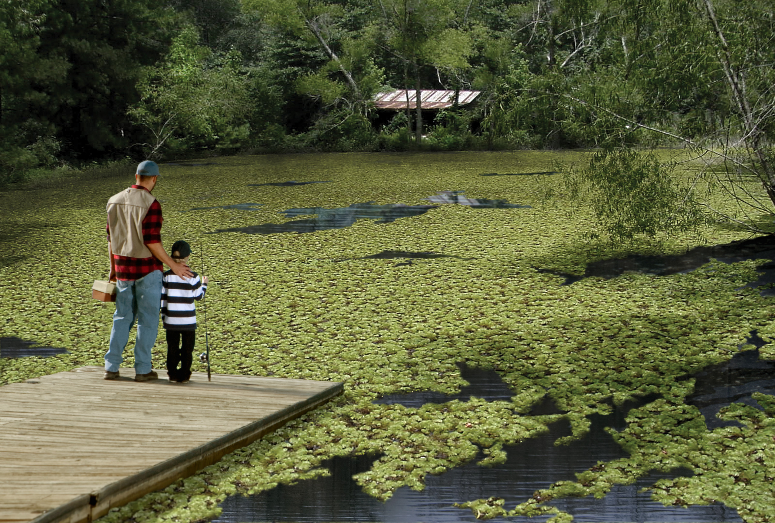
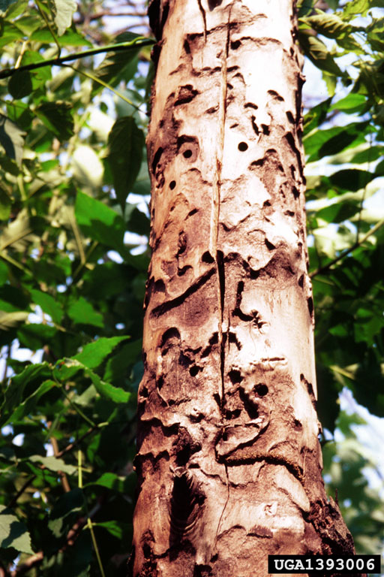
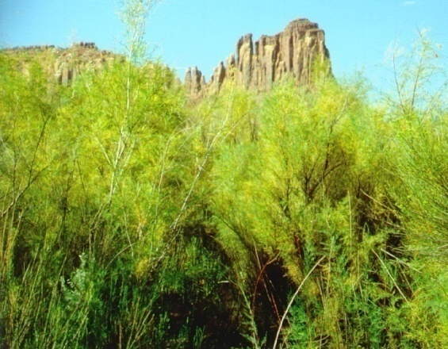
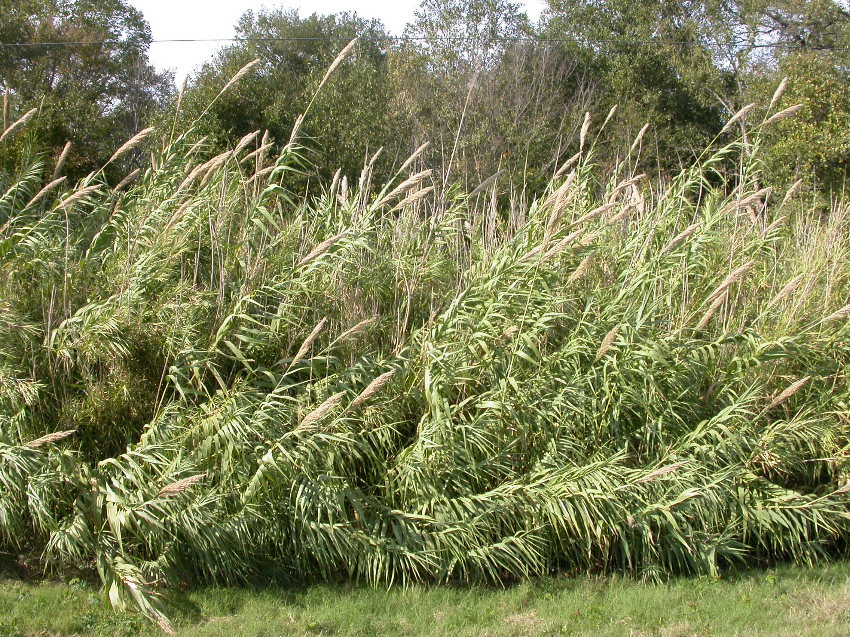
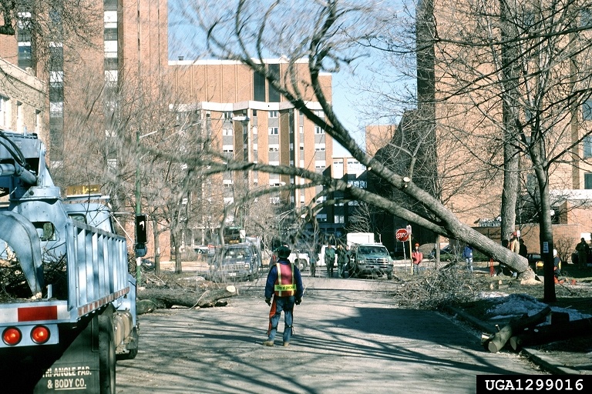
Sentinel Pest Network: Who, How, & Why Our Approach to a Very Serious Problem….
Notes:
I think invasive species are really a unique problem because of the way they impact their surroundings. so wide ranging that most people regardless of their background, where they live, or demographic have had a bad run-in with an invasive species in some way.
They alter our surroundings and effect society and individuals in so many different ways that most people can relate to the problem of invasive species:
Recreationalists
Agricultural community
Logging industry
Conservationists
Gardeners and park-goers
Negatively impact society in that costs of goods such as produce, nursery plants, paper goods go up, but also the quality of our surroundings. Our parks and roadsides are overtaken and our trees and plants are risk. All of this impacts are as they relate to humans, does not even cover the impacts to the local biota and ecosystem function.
The risks from invasive pests stretch well beyond agriculture and affect everyone. When exotic insect pests are excluded from the local ecosystems, we all benefit in the form of lower food costs, increased recreational value of public and private lands and protection of urban and rural landscapes.

Slide 3
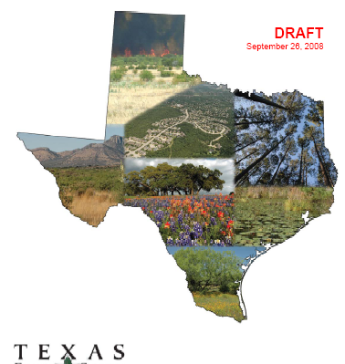
Sentinel Pest Network:
Why Texas?
268,581 sq. miles
9 ecoregions
3,822 miles of border
Directly exposed to intruders from South, Great Plains, West and Mexico
Annual influx of“snowbirds”
Ron Billings, Texas Forest Service

Slide 4
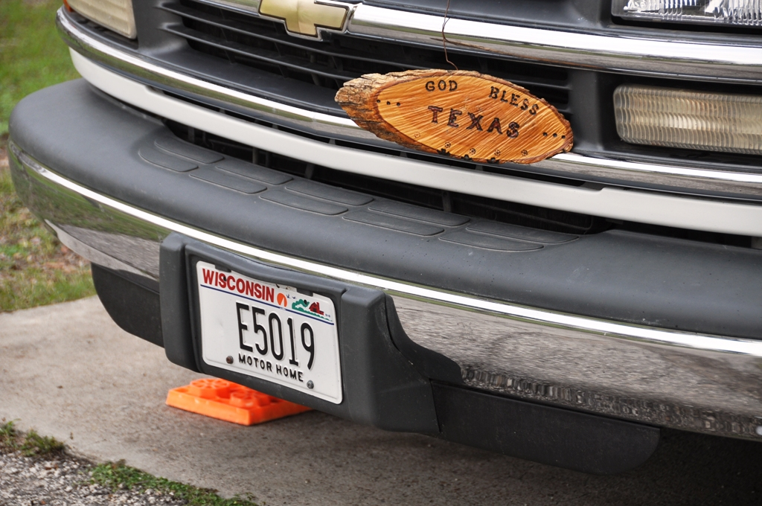

Slide 5
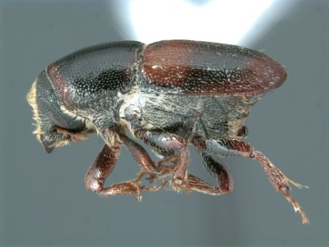
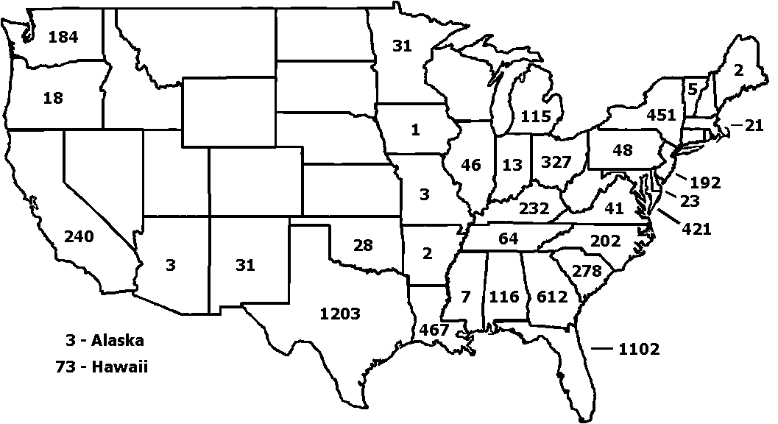
Sentinel Pest Network:
Why Texas?
6825 Bark Beetle Interceptions: 1985-2000 (Family Scolytidae)
18% of Total in Texas
164 - PR
21 - VI
Ron Billings, Texas Forest Service

Slide 6
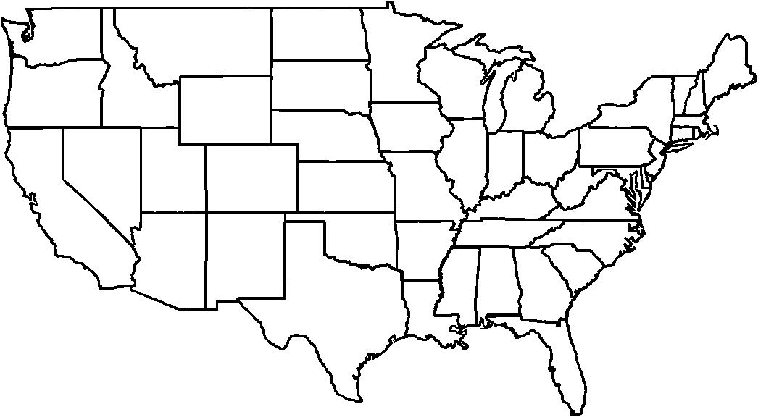
Sentinel Pest Network:
Why Texas?
1649 Cerambycidae Interceptions: 1985-2000
(Round-headed Wood Borers)
12% in Texas
167
36
5
1
25
133
3 - MA
3
9
1 - CT
19
8
1
4
9 - DE
85- NJ
17- MD
34
13
247
1
12
20
30
47
67
5
9
114
202
37 - HI
3 - Other
179 - FL
72 - PR
31 - VI
Ron Billings, Texas Forest Service

Slide 7







Sentinel Pest Network: WHO, How, & Why Project Partners
U.S.D.A – Animal Health & Plant Inspection Service (APHIS)
Texasinvasives.org & The Invaders of Texas Program
Lady Bird Johnson Wildflower Center
Texas Forest Service
Texas Parks and Wildlife
Many more….
YOU!!
Notes:
U.S.D.A – Animal Health & Plant Inspection Service (APHIS)
Funding for workshops
Pest alerts
Rapid response to minimize damage
High quality online resources
Hungrypests.com
Beetlebusters.info
Texasinvasives.org & The Invaders of Texas Program
Online clearinghouse of information for the general public and professionals
YOU!!
Prevention
Don’t Move Firewood
Educating yourself
Action
Reporting

Slide 8
The “Dirty Dozen” Pest List
COMMON NAME | SCIENTIFIC NAME
Asian Longhorned Beetle | Anoplophora glabripennis
Brown Fir Longhorned Beetle | Callidiellum villosulum
Cactus Moth | Cactoblastis cactorum
Emerald Ash Borer | Agrilus planipennis
Spongy Moth | Lymantria dispar
Sirex Woodwasp | Sirex noctilio
Cogongrass | Imperata cylindrica
Giant Hogweed | Heracleum mantegazzianum
Onionweed | Asphodelus fistulosus
Tropical Soda Apple | Solanum viarum
Tropical Spiderwort | Commelina benghalensis
Giant African Land Snail | Lissachatina fulica

Slide 9
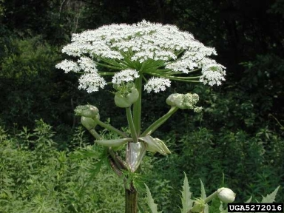
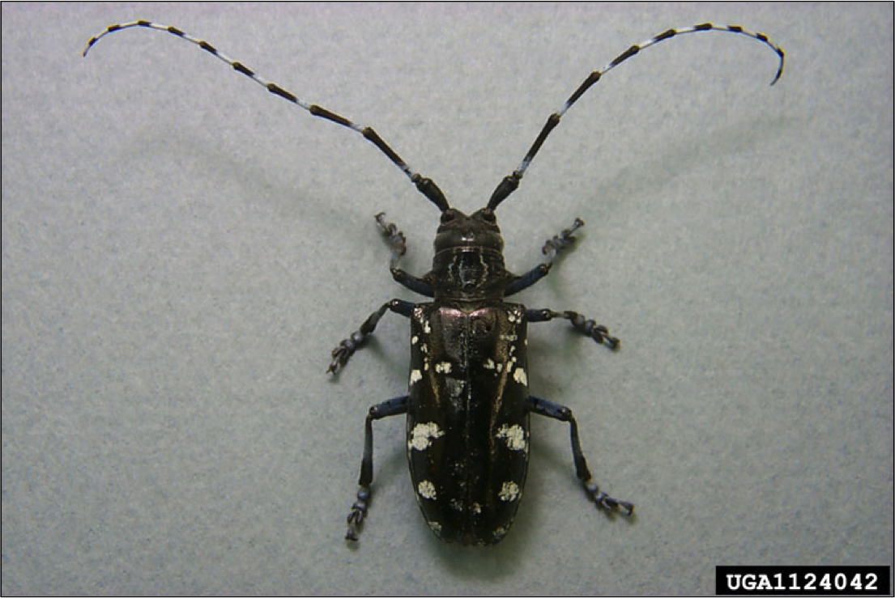
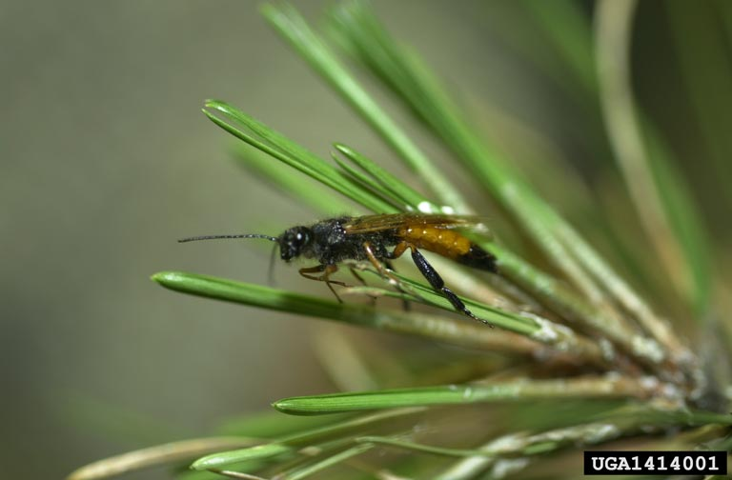
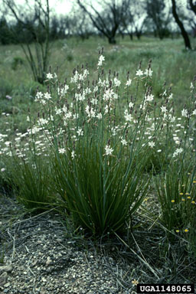
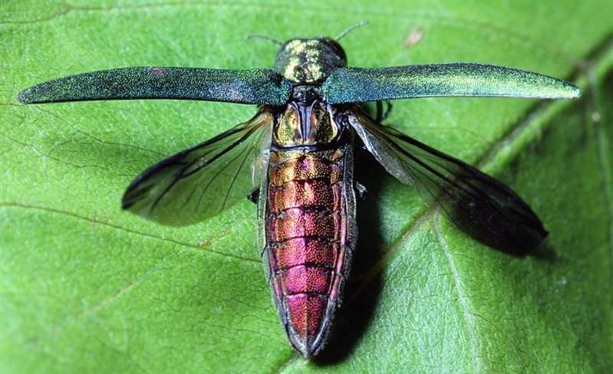
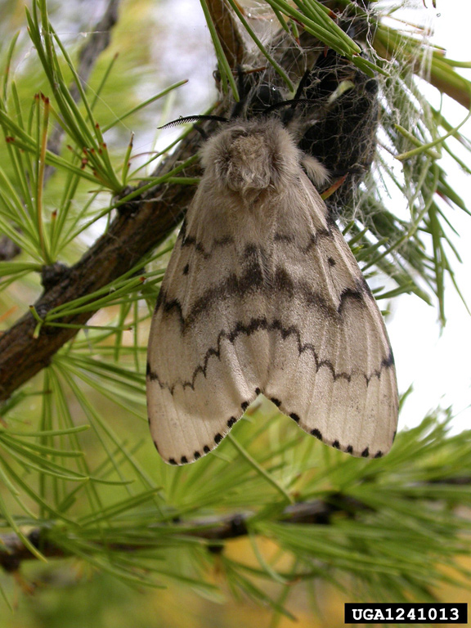
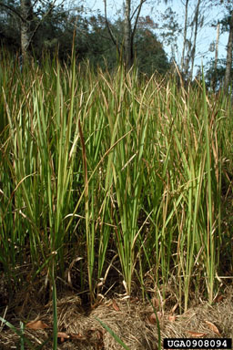
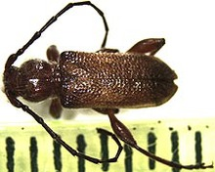
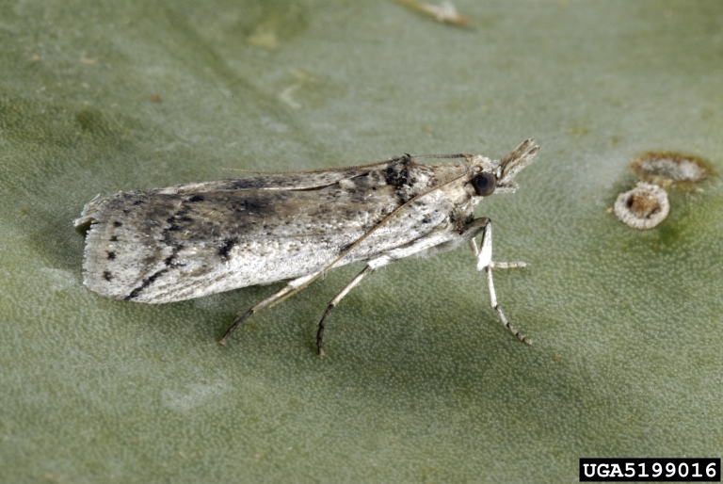
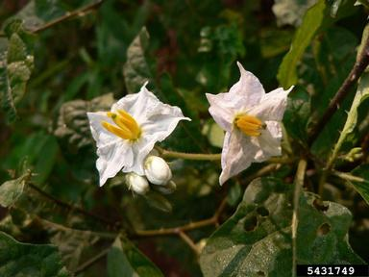
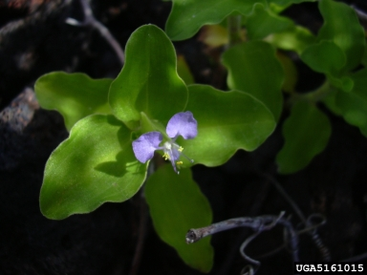
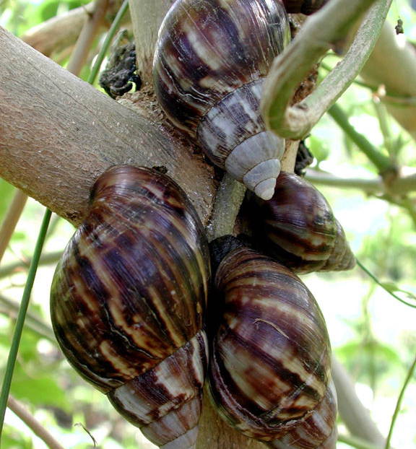
The “Dirty Dozen” Pest List
Where Are They Now?

Slide 10
Asian Longhorned Beetle Anoplophora glabripennis
Order: Coleoptera
Family: Cerambycidae

Slide 11
Asian Longhorned Beetle Introduction & Distribution
Native Range: China
U.S. Transmission: solid wood packing material (1st Discovery: Brooklyn New York, 1996)
U.S. Distribution:
SUCCESS STORY!!:
Illinois Eradication (2008)
States with Infestations:
Massachusetts
New Jersey
New York
Ohio
U.S Spread:
Infested nursery stocks
Firewood
Vehicles
www.beetlebusters.info
Beetlebusters.info
Notes:
US Entry and Spread:
Determined by USDA officials to have entered the United States inside solid wood packing material (SWPM) from China, the ALB was first discovered in August 1996 in the Greenpoint neighborhood of Brooklyn, NY. Within weeks, another infestation was found on Long Island in Amityville, NY, after officials learned that infested wood had been moved from Greenpoint to Amityville.
In July 1998, due to USDA’s national ALB pest alert campaign, a separate infestation was discovered in the Ravenswood area of Chicago. This discovery prompted APHIS to amend its existing quarantine of wood movement in infested areas and place additional restrictions on importing solid wood packing material into the United States from China and Hong Kong.
It was in October 2002 that ALB was spotted in Jersey City, NJ, and most recently, in August 2004, the ALB was discovered in the Borough of Carteret, the Avenel section of Woodbridge Township, and in the nearby cities of Rahway and Linden, NJ. The most recent discoveries, all within a two–square–mile area, mark the first time since 2002 that the invasive exotic pest has been seen outside the quarantined regions of Chicago, New York, and Jersey City, NJ. (USDA-APHIS, 2005)
The ALB has also become established in Europe – 1 site in Austria, 3 in France, 2 in Germany, and 1 in Italy (Haack et al. 2010). At all of these sites, the Asian longhorned beetle is believed to have been present for years before its presence was noticed.
There has been success in the fight against invasive pests. The Asian longhorned beetle, detected in Illinois in 1998, was declared eradicated from Illinois in 2008 with the help of local, state and federal partners and Illinois residents. The beetle was also declared eradicated from Hudson County, NJ; and Islip, NY. Extensive efforts by USDA and its partners in California reduced European grapevine moth populations in 2011 by 99.9 percent. That pest was first detected in California in 2009.
With proper treatment and eradication efforts, we can get rid of the ALB. The insect has been successfully eradicated from Chicago, Illinois and Hudson County, New Jersey.

Slide 12
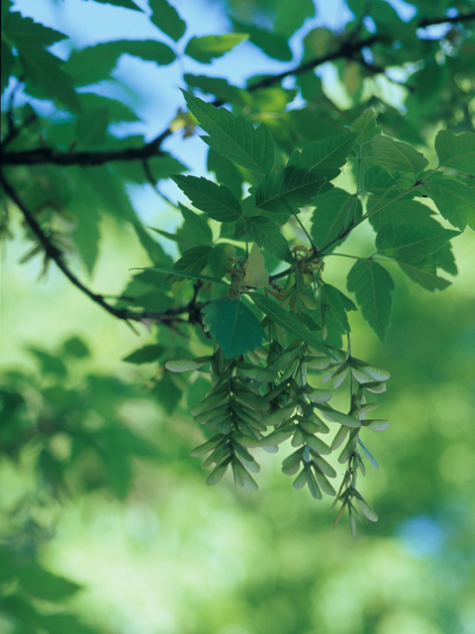
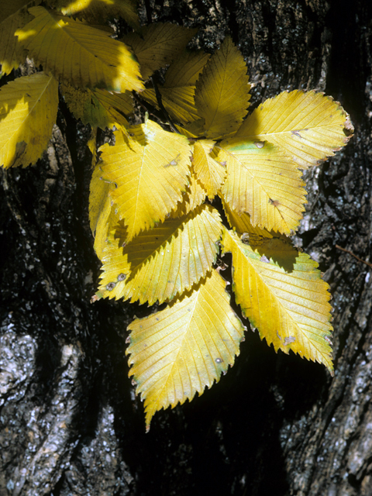
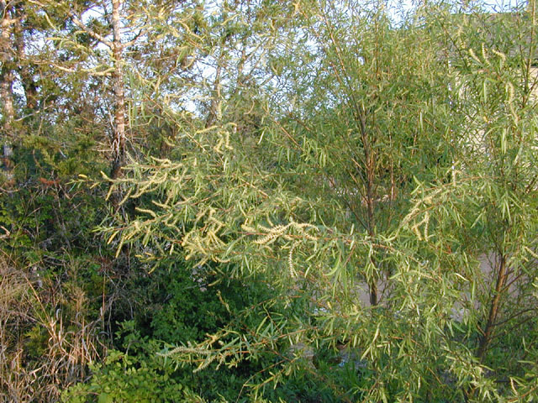
Asian Longhorned Beetle Biology: Host Trees
More than 15 host trees
Most commonly attacks:
Maples (Acer)
Elms (Ulmus)
Willows (Salix)

Slide 13
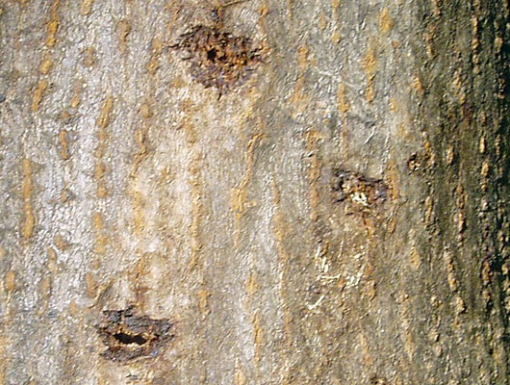
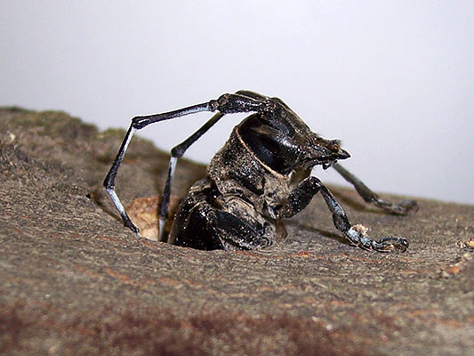
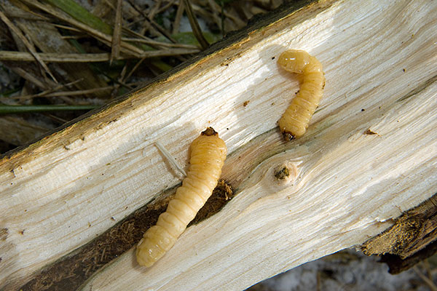
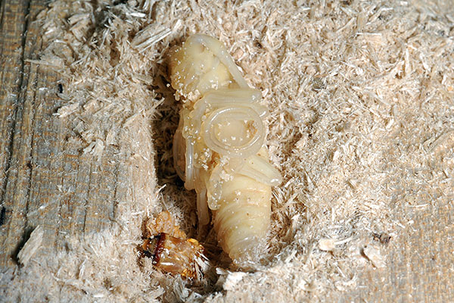
Asian Longhorned Beetle Biology: Life Cycle
Notes:
The female ALB chews depressions (oviposition sites) in the bark of trees to lay eggs. A single female beetle can lay from 35 to 90 eggs. Hatching within 10 to 15 days, the worm–like immature beetles tunnel under tree bark and bore into healthy hardwood trees. The beetle larvae feed on living tree tissue during the fall and winter and, after pupating, emerge through exit holes during the spring. After emerging, adult beetles feed on tree exteriors for 2 to 3 days, then mate. Adult beetles remain active only during summer and early fall months before perishing—completing a 1–year life cycle. (USDA-APHIS, 2005)
The Asian longhorned beetle (ALB) spends most of its life as a larva inside a hardwood tree. The adult female ALB chews a depression or egg site into the bark and lays a single egg beneath the bark. Egg sites are visible on the bark of the tree. They can be oval or round in shape or small slits depending on the tree species and thickness of the bark. With a lifespan of 14-66 days, a female ALB can lay 30-60 eggs in her lifetime.
When the larva emerges from the egg, it initially feeds on the tree’s living tissue directly beneath the bark. The mature larva then moves deep into the tree and feeds on the woody tissue. This feeding and burrowing causes the tree to weaken and eventually die. The larva becomes a pupa inside the tree.
About one year after the egg was laid, the adult beetle breaks out of its pupal casing and chews its way out of the tree, creating perfectly round exit holes that are about 3/8” in diameter. Adult beetles emerge in July and August. They feed on leaves and small twigs and then mate, continuing the life cycle with the female beetles laying more eggs in the tree. Female beetles tend to lay eggs on the same tree every year until the tree dies.

Slide 14
Asian Longhorned Beetle Biology: Life Cycle
Notes:
The female ALB chews depressions (oviposition sites) in the bark of trees to lay eggs. A single female beetle can lay from 35 to 90 eggs. Hatching within 10 to 15 days, the worm–like immature beetles tunnel under tree bark and bore into healthy hardwood trees. The beetle larvae feed on living tree tissue during the fall and winter and, after pupating, emerge through exit holes during the spring. After emerging, adult beetles feed on tree exteriors for 2 to 3 days, then mate. Adult beetles remain active only during summer and early fall months before perishing—completing a 1–year life cycle. (USDA-APHIS, 2005)
The Asian longhorned beetle (ALB) spends most of its life as a larva inside a hardwood tree. The adult female ALB chews a depression or egg site into the bark and lays a single egg beneath the bark. Egg sites are visible on the bark of the tree. They can be oval or round in shape or small slits depending on the tree species and thickness of the bark. With a lifespan of 14-66 days, a female ALB can lay 30-60 eggs in her lifetime.
When the larva emerges from the egg, it initially feeds on the tree’s living tissue directly beneath the bark. The mature larva then moves deep into the tree and feeds on the woody tissue. This feeding and burrowing causes the tree to weaken and eventually die. The larva becomes a pupa inside the tree.
About one year after the egg was laid, the adult beetle breaks out of its pupal casing and chews its way out of the tree, creating perfectly round exit holes that are about 3/8” in diameter. Adult beetles emerge in July and August. They feed on leaves and small twigs and then mate, continuing the life cycle with the female beetles laying more eggs in the tree. Female beetles tend to lay eggs on the same tree every year until the tree dies.

Slide 15
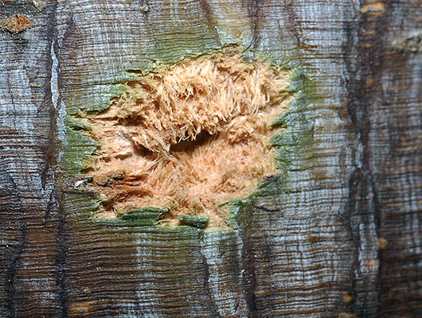
Asian Longhorned Beetle Biology: Life Cycle
Egg Sites:
Female chews depression
Lays 35 – 90 eggs
Hatch within 10-15 days
Notes:
The female ALB chews depressions (oviposition sites) in the bark of trees to lay eggs. A single female beetle can lay from 35 to 90 eggs. Hatching within 10 to 15 days, the worm–like immature beetles tunnel under tree bark and bore into healthy hardwood trees.
The Asian longhorned beetle (ALB) spends most of its life as a larva inside a hardwood tree. The adult female ALB chews a depression or egg site into the bark and lays a single egg beneath the bark. Egg sites are visible on the bark of the tree. They can be oval or round in shape or small slits depending on the tree species and thickness of the bark. With a lifespan of 14-66 days, a female ALB can lay 30-60 eggs in her lifetime.

Slide 16
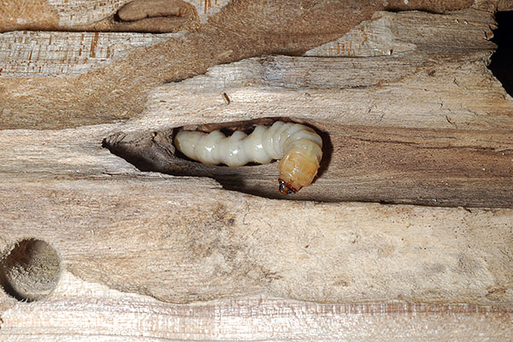
Asian Longhorned Beetle Biology: Life Cycle
Larvae:
Feed on living tissue
Fall and winter
Notes:
Hatching within 10 to 15 days, the worm–like immature beetles tunnel under tree bark and bore into healthy hardwood trees. The beetle larvae feed on living tree tissue during the fall and winter.
When the larva emerges from the egg, it initially feeds on the tree’s living tissue directly beneath the bark. The mature larva then moves deep into the tree and feeds on the woody tissue. This feeding and burrowing causes the tree to weaken and eventually die.
The larva becomes a pupa inside the tree.

Slide 17
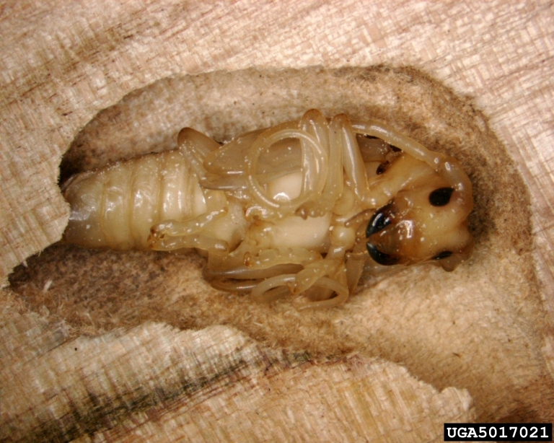
Asian Longhorned Beetle Biology: Life Cycle
Notes:
After pupating, emerge through exit holes during the spring. After emerging, adult beetles feed on tree exteriors for 2 to 3 days, then mate. Adult beetles remain active only during summer and early fall months before perishing—completing a 1–year life cycle. (USDA-APHIS, 2005)

Slide 18
Asian Longhorned Beetle Biology: Life Cycle
Notes:
After emerging, adult beetles feed on tree exteriors for 2 to 3 days, then mate. Adult beetles remain active only during summer and early fall months before perishing—completing a 1–year life cycle. (USDA-APHIS, 2005)
The adult beetle breaks out of its pupal casing and chews its way out of the tree, creating perfectly round exit holes that are about 3/8” in diameter. Adult beetles emerge in July and August. They feed on leaves and small twigs and then mate, continuing the life cycle with the female beetles laying more eggs in the tree. Female beetles tend to lay eggs on the same tree every year until the tree dies.

Slide 19
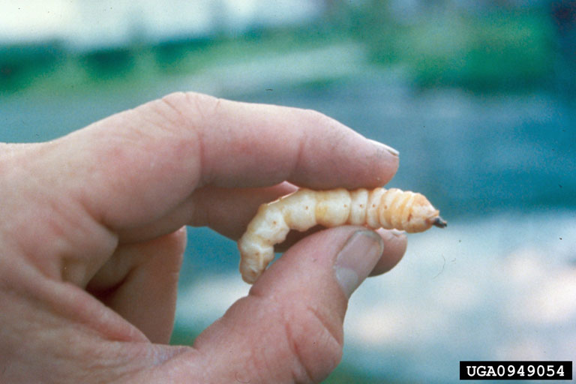
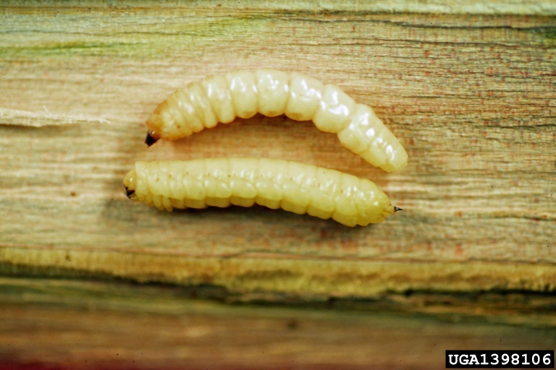
Asian Longhorned Beetle Identification: Larvae
Larvae:
White
Caterpillar-like

Slide 20
Asian Longhorned Beetle Identification: Adults
Beetlebusters.info
Notes:
1 to 1 ½ inches in length
Long antennae banded with black and white (longer than the insect’s body)
Shiny, jet black body with distinctive white spots
Six legs
May have blue feet

Slide 21
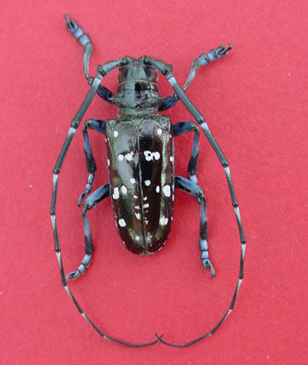
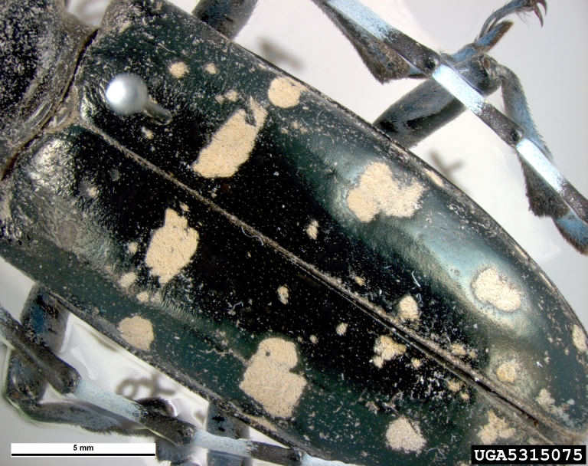
Asian Longhorned Beetle Identification: Adults
Notes:
1 to 1 ½ inches in length
Long antennae banded with black and white (longer than the insect’s body)
Shiny, jet black body with distinctive white spots
Six legs
May have blue feet

Slide 22
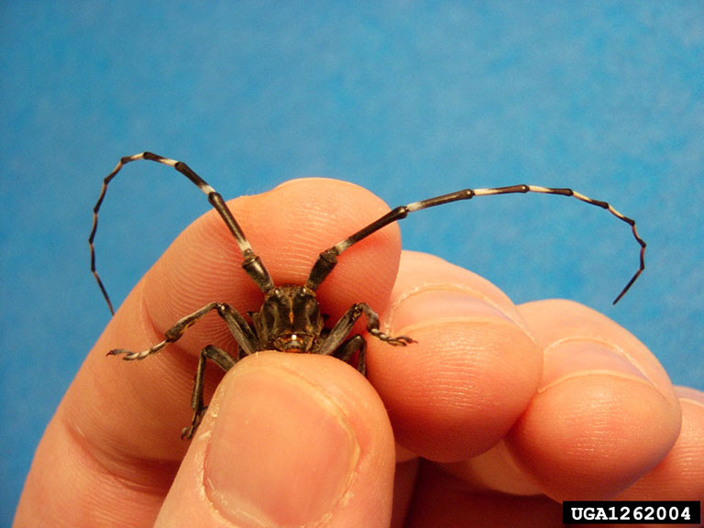
Asian Longhorned Beetle Identification: Adults

Slide 23
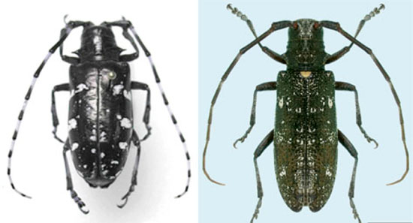
Asian Longhorned Beetle Identification: Native Look-Alikes
MOST COMMON MIS-ID
Whitespotted sawyer:
White spot between wings (absent on ALB)
Wings bronze-black and rough (ALB are smooth shiny black)
1
¹Invasive.org

Slide 24
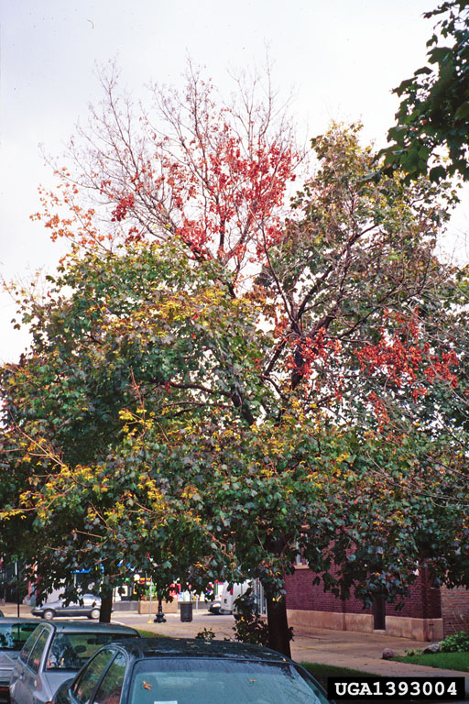
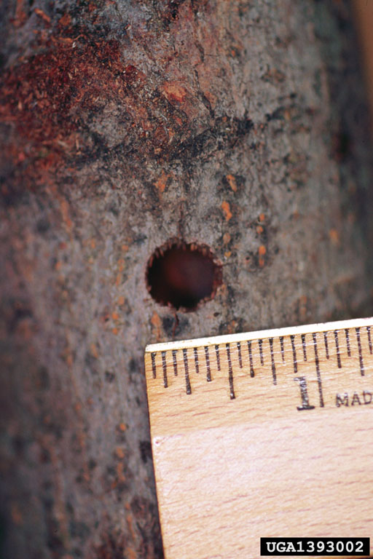
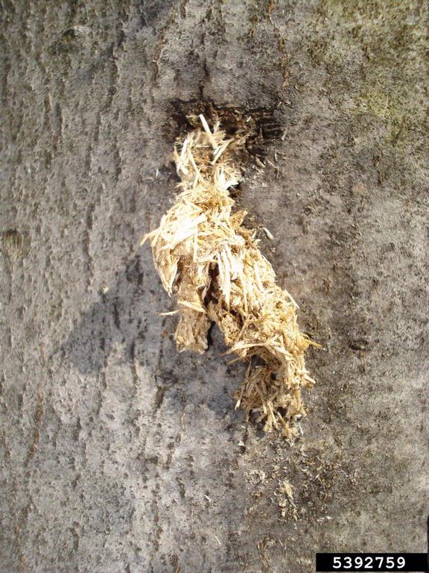
Asian Longhorned Beetle Signs and Symptoms
Wilting & yellowing leaves
Dime-sized exit holes
Burrowing
“Saw-dust”:
frass
Notes:
While it can fly, the beetle tends to lay eggs in the same tree from which it emerged as an adult.
In addition to looking for the beetle, you can search for signs of infestation, including:
Shallow divits in the bark where the eggs are laid
Sap seeping from wounds in the tree
Dime-sized (1/4” or larger), perfectly round exit holes in the tree
Sawdust-like materials, called frass, on the ground and the branches
Visible Asian longhorned beetles. Adult beetles have bullet-shaped bodies from 3/4 inch to 1-1/2 inches long, shiny black with white spots and long striped antennae, 1-1/2 to 2-1/2 times the size of its body.
A series of chewed round depressions in the bark of a tree
Pencil-sized, perfectly round tree exit holes
Excessive sawdust buildup near tree bases
Unseasonable yellowed or drooping leaves

Slide 25
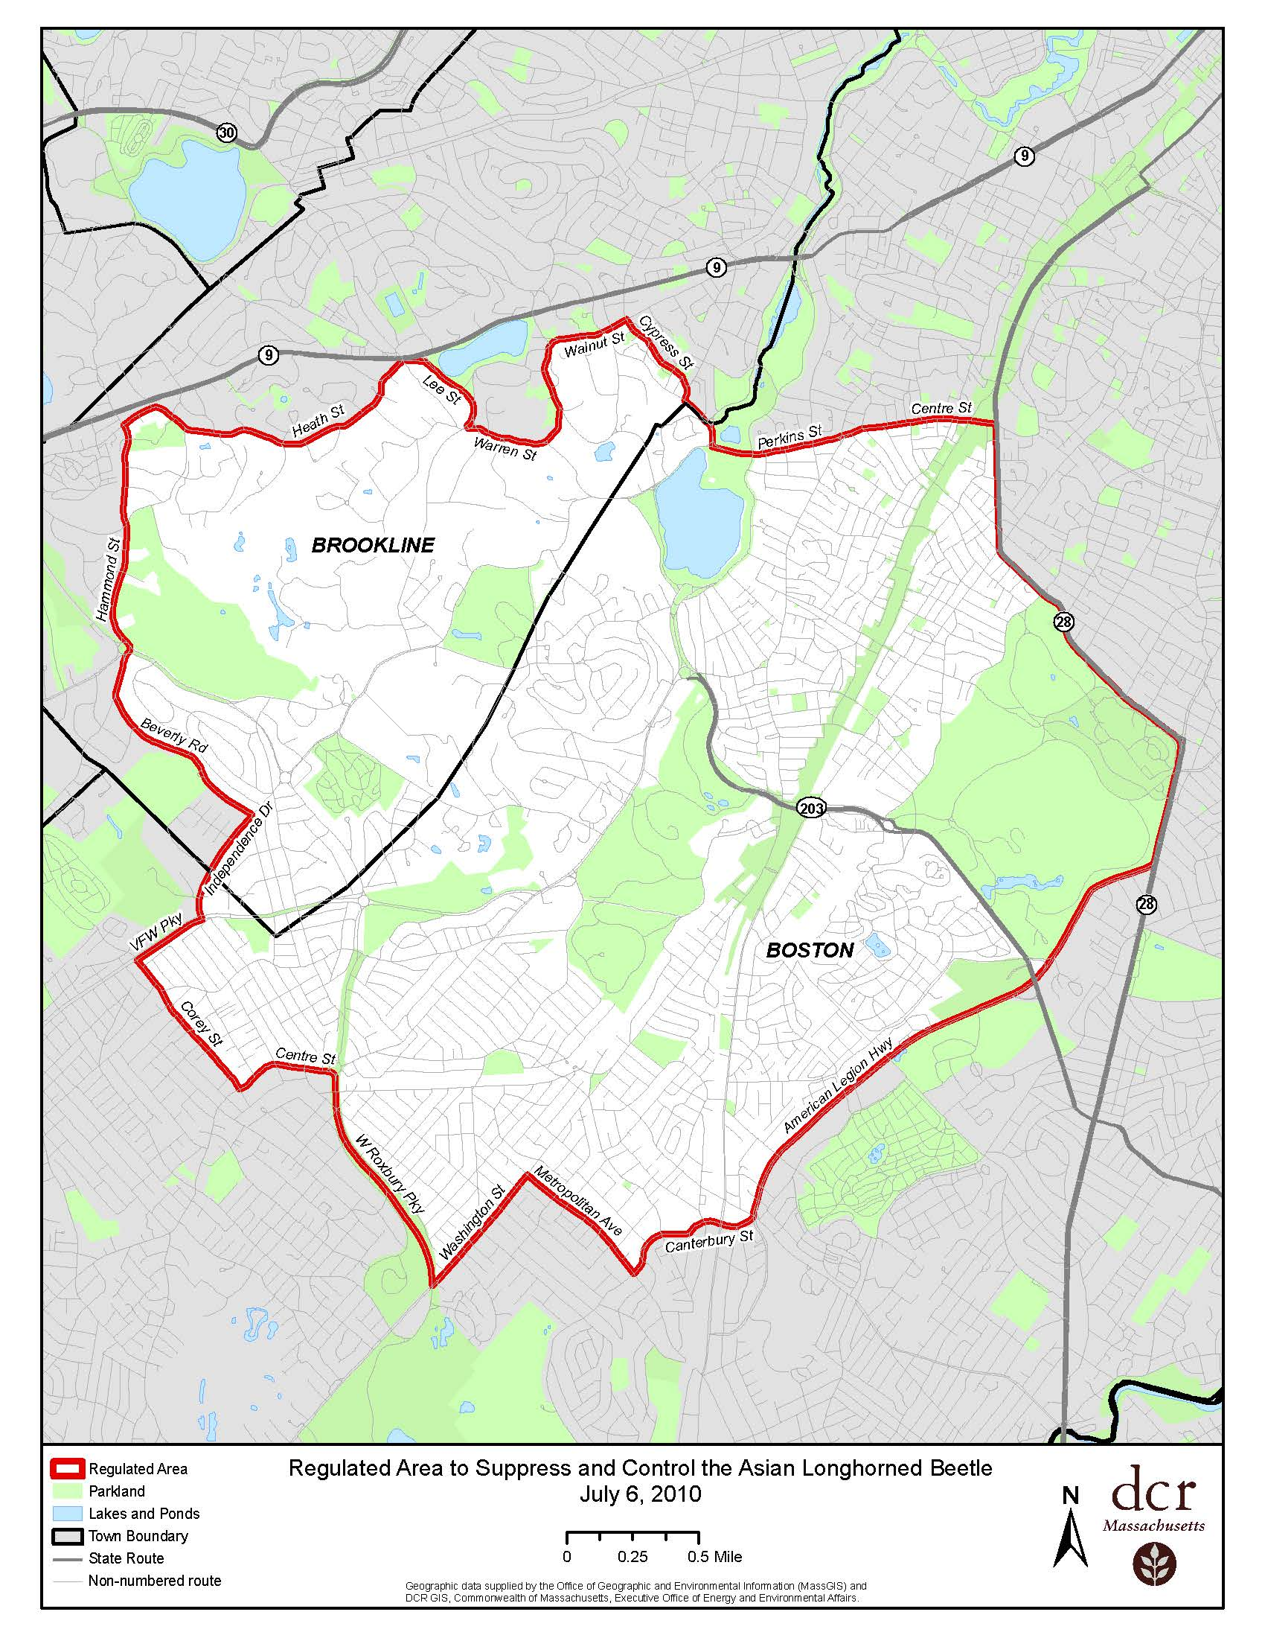
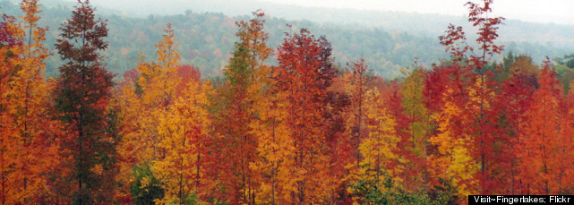
Asian Longhorned Beetle Damages & Control Efforts
DAMAGE:
Urban forests:
1/3 of urban trees nationwide are susceptible
Compensatory Value: $669 billion¹
Agricultural:
Timber industry
Maple syrup
Nursery production
Recreational tourism
CONTROL:
Prevention: Early Detection & Rapid Response (EDRR)
International Plant Protection Convention (IPPC) import requirements
Customs & Border Protection (CBP) inspections
Quarantine zones
Treatment:²
Chemical: Imidacloprid
Applied to trunk or soil
Spring application
Outreach
www.beetlebusters.info
www.hungrypests.com
¹Nowak et al., 2001; ²www.beetlebusters.info
Notes:
DAMAGES:
Economic losses would be greatest to the urban forest. A study of seven cities in the northeast and north central regions (Baltimore, Boston, Chicago, Jersey City, New York City, Philadelphia, and Syracuse) found that half of their trees are vulnerable to Asian longhorned beetle. The estimated cost to remove and replace the trees killed (called compensatory value) would vary from $72 million in Jersey City to $2.2 billion in New York City. Nationwide, the Asian longhorned beetle could kill a third of urban trees, which have a compensatory value of $669 billion (Nowak et al., 2001). In rural areas, the Asian longhorned beetle would damage a range of commercial interests. One obvious impact would be on timber production. Discounted monetary losses for timber resources around Chicago and New York would range from $1 to $10 million 30 years after introduction (USDA APHIS & Forest Service, 2000). Other industries likely to be affected include maple syrup production, nursery production, and "leaf peeper" tourism. In 2007, maple syrup production was valued at $41.7 million. In Vermont alone, the multiplier effect of the maple sugar industry to related equipment, manufacturing, packaging, and retail sectors equals $105 million annually and represents 4,000 seasonal jobs (USDA National Ag. Statistics Service, 2009; Andrienne Wojciechowski , pers. comm. December 2008). One million tourists intent on viewing autumn foliage generate $1 billion in revenue in New England each year (USDA APHIS, 1998). Maples are noted for producing some of most vivid colors that draw these tourists (USDA APHIS, 1998). DON’T MOVE FIREWOOD
The beetle has the potential to damage such industries as lumber, maple syrup, nursery, and tourism accumulating over $41 billion in losses.
Q. Is there an effective treatment to control or destroy these pests? A. While ALB-infested cargo can be effectively treated, it is not easy to control ALB once it is introduced to the environment. Although costly and undesirable, the only assured method of eliminating the beetle is to cut and chip infested trees.
Working together with State and local cooperators, APHIS also treats host trees not infested with ALB during spring months in targeted locations within infested areas.
Top
Q. What insecticide is used? A. Several insecticides with the active ingredient, imidacloprid, are approved for use within the ALB treatment program.
Top
Q. How are the insecticide injections made to the tree? A. Imidacloprid is applied through either tree trunk or soil injections under USDA supervision. Trunk injections are applied directly into the trunk of the tree. Soil injections are applied directly into the soil around the base of the tree. The number of injections (trunk or soil) required per tree is dependent on the size of the tree. With both methods of injection, the insecticide moves upward into stems, twigs, and foliage. The intent of the injection treatments is to deliver the active ingredient of the pesticide to active tree-growth areas, where the beetle would be expected to feed and lay eggs.
Top
Q. Where and when do applications take place? A. Treatments will be applied to the ALB-infested areas in the spring.
B

Slide 26
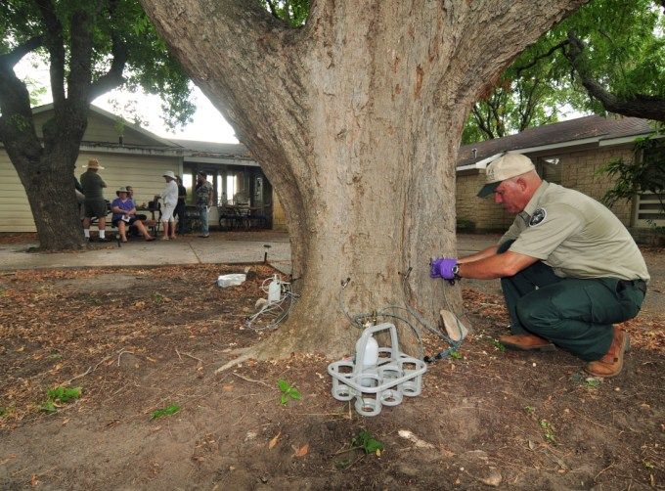

Slide 27
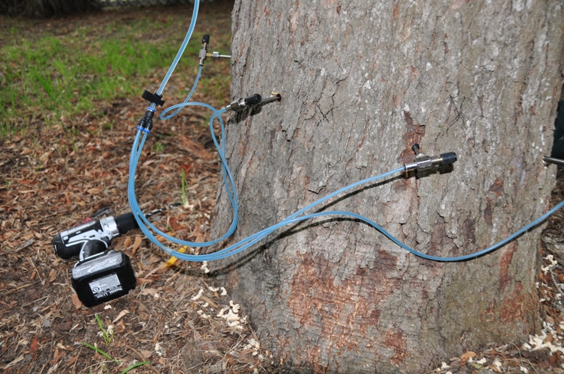

Slide 28
Brown Fir Longhorned Beetle Callidiellum villosulum
Order: Coleoptera
Family: Cerambycidae
CPB/USDA

Slide 29
Brown Fir Longhorned Beetle Introduction & Distribution
Native Range: China
U.S. Transmission: artificial Christmas trees
U.S. Distribution: NO established populations
1
2
¹www.backyardgardener.om/zone/china.html. ²Glenn Fowler
Notes:
Callidiellum villosulum (Fairmaire), also known as the Brown Fir Longhorned Beetle, has been found in real wood trunks of artificial Christmas trees imported from China. During the time period 1999 – 2001, more than 20 interceptions of this species were recorded (Lingafelter, pers. comm.) . In March 2011 it was intercepted again in a Baltimore port
“Callidiellum villosulum is native to Henan, Jiangsu, Zhejiang, and Fujian Provinces in China” (EXFOR pest report). A hardiness zone map of China demonstrates that all are in hardiness zones 8 and 9 (China Plant hardiness map; Fig. 2). Comparison to US hardiness zones for the states that bear host trees native to China demonstrates that coastal North Carolina, the southern half of Alabama, and virtually all of Louisiana have suitable climates for Callidiellum villosulum (US zones 8 to 11; Fig. 3). In addition, if the host trees in California prove to be susceptible, they fall within the hardiness risk zone for this beetle as well.

Slide 30
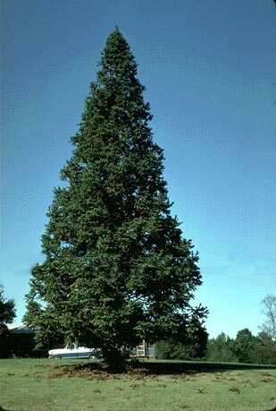
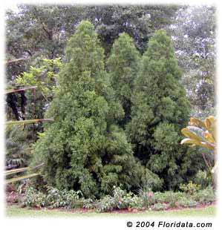
Brown Fir Longhorned Beetle Biology: Host Trees
China Fir (Cunninghamia lanceolata)
Japanese Cedar (Cryptomeria japonica)
1
¹dendrome.ucdavis.edu
Notes:
There are some additional points which may improve the EXFOR ratings. The pest report states “the ability of Callidiellum villosulum to adapt to North American conifers in not known. Its hosts are two genera of conifers not represented in North America.”. However, a search of the PLANTS database (USDA, NRCS, 2004) demonstrated that both hosts mentioned, Cunninghamia lanceolata and Cryptomeria japonica, are represented by naturalized populations in the US in the states of North Carolina, Alabama, and Louisiana. In addition, these same hosts are present in California arboreta,
Callidiellum villosulum has one generation per year in Zhejiang Province (southeastern coastal China). It overwinters as an adult inside the pupal cell, which is located at the end of the larval gallery in the sapwood. By the end of February, the adults become active inside the pupal cell, and chew an exit hole through the wood and bark. In early March, adults begin to emerge. Peak emergence occurs from late March to early April. Adults continue to appear into early May. Upon emergence, adults seek out mates. Mating usually occurs from 8 am to 10 am and multiple matings can occur. Oviposition occurs from mid-March through mid-May. Eggs are laid in the cracks of tree bark. Adults do not feed. Eggs hatch beginning in late March. The young larvae tunnel into the cambium. Larval galleries are rounded on the sides but flattened top to bottom. They are packed with frass and sawdust. In August, the mature larvae tunnel into the sapwood and construct oval-shaped tunnels about 1 cm long. Sometimes these tunnels can be as long as 3-5 cm. In late September, pupation begins and lasts from 10-15 days. In early October, the pupae transform into adults. By late November, the adult blocks the larval gallery with sawdust and overwinters inside the pupal cell. If spring temperatures are low, overwintering adults will suffer high mortality (Anonymous n.d., Zhu Chang-qing et al 1999).
William M. Ciesla
Forest Health Management International
2248 Shawnee Court
Fort Collins, CO
USA 80525

Slide 31
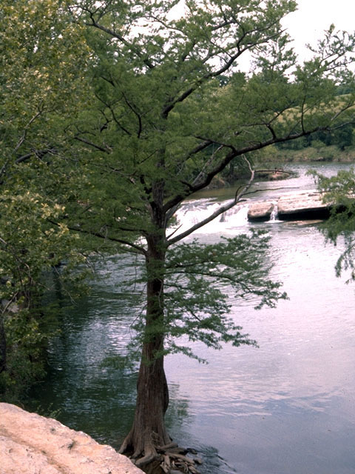
Brown Fir Longhorned Beetle Biology: Host Trees
Host Trees NOT in U.S.
Naturalized populations in:
North Carolina
Alabama
Louisiana
Taxodiaceae may be susceptible
Redwood (Sequioa sempervirens)
Giant Sequoia (Sequoiadendron giganteum)
Bald Cypress (Taxodium distichum)
Notes:
There are some additional points which may improve the EXFOR ratings. The pest report states “the ability of Callidiellum villosulum to adapt to North American conifers in not known. Its hosts are two genera of conifers not represented in North America.”. However, a search of the PLANTS database (USDA, NRCS, 2004) demonstrated that both hosts mentioned, Cunninghamia lanceolata and Cryptomeria japonica, are represented by naturalized populations in the US in the states of North Carolina, Alabama, and Louisiana. In addition, these same hosts are present in California arboreta, and there is a concern for “North American representatives of Taxodiaceae, namely redwood, Sequioa sempervirens; giant sequoia, Sequoiadendron giganteum; and bald cypress, Taxodium distichum. These trees tend to be geographically restricted” and “if they prove to be susceptible to this insect, the unique ecosystems in which they occur could be seriously compromised” (EXFOR pest report).
Brown fir longhorned beetles may be a threat to arborvitae, cypress, juniper, cedar and possibly other landscape plants. The genus Callidiellum is comprised of three established species in North America: the native cupressi from coastal California, viridescens from Arizona, and rufipenne, first detected in North America in 1927 and most recently found in North Carolina and Connecticut. The species C. villosulum is found in eastern China and is considered a secondary pest because it preferentially attacks only weakened or freshly felled conifers.
The brown fir longhorned beetle is considered a pest of moderate consequences in its natural range, where it infests Chinese fir (Zhu Chang-qing et al. 2000). It usually attacks 3-5 year-old trees, but can also infest the upper branches of mature trees. The larvae feed in the cambium, between the bark and wood, creating irregular oval-shaped galleries that cut off nutrient and water flow within the trunk, and thereby cause tree death. The mature larvae also penetrate into the sapwood, which lowers the both the quality and structural integrity of lumber. This insect can kill trees, but attacks are restricted to small trees or branches of larger trees.
William M. Ciesla
Forest Health Management International
2248 Shawnee Court
Fort Collins, CO
USA 80525

Slide 32
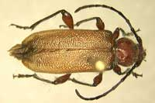
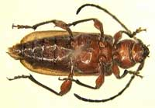
Brown Fir Longhorned Beetle Identification: Adults
Adults:
Chestnut brown color
6 – 12 mm in length
Body covered in long greyish setae
Head and thorax have shallow punctures
Top View
Bottom View
Notes:
Adults are 6-12 mm long, chestnut brown color, with the entire body thinly covered with long grayish setae. Head and thorax have shallow punctures and the frons is square-shaped. There is a transverse ridge between the antennae. The antennae are brownish-black. The male antennae are slightly longer than the body, whereas the female antennae are about two-thirds of the body length. The scape of the antennae are coarsely punctured. The prothorax is wider than its length, and the two sides are rounded with no lateral spikes. The prothorax has some hardly visible raised tubercles. The ventral portion of the thorax and the femur of all legs are brownish-red. The femur on all legs is thickened. The basal portion of the elytra are chestnut colored, while the other portion of the elytra is light yellowish-brown and has deeper punctures than those on the thorax. The apical tip of each elytron is rounded.
William M. Ciesla
Forest Health Management International
2248 Shawnee Court
Fort Collins, CO
USA 80525

Slide 33
Brown Fir Longhorned Beetle Identification: Adults
Ohio Department of Agriculture
Notes:
Adults are 6-12 mm long, chestnut brown color, with the entire body thinly covered with long grayish setae. Head and thorax have shallow punctures and the frons is square-shaped. There is a transverse ridge between the antennae. The antennae are brownish-black. The male antennae are slightly longer than the body, whereas the female antennae are about two-thirds of the body length. The scape of the antennae are coarsely punctured. The prothorax is wider than its length, and the two sides are rounded with no lateral spikes. The prothorax has some hardly visible raised tubercles. The ventral portion of the thorax and the femur of all legs are brownish-red. The femur on all legs is thickened. The basal portion of the elytra are chestnut colored, while the other portion of the elytra is light yellowish-brown and has deeper punctures than those on the thorax. The apical tip of each elytron is rounded.
William M. Ciesla
Forest Health Management International
2248 Shawnee Court
Fort Collins, CO
USA 80525

Slide 34


Brown Fir Longhorned Beetle Damages & Control Efforts
DAMAGE:
Potential Harm To:
Christmas tree industry
Plantation forestry
Taxodiaceae
CONTROL:
Prevention: EDRR
IPPC & CBP requirements and inspections
www.babble.com
Notes:
Baltimore CBP Intercepts First Brown Fir Longhorned Beetle
(Monday, March 28, 2011)
Baltimore – A U.S. Department of Agriculture entomologist confirmed over the weekend that a recent Customs and Border Protection insect discovery was the agency’s first interception of a Brown Fir Longhorned Beetle in Baltimore.
All wood packing materials, such as pallets, crates, boxes and pieces of bracing, must meet strict International Plant Protection Convention (IPPC) import requirements and be free of timber pests before entering or transiting through the United States. Wood packing material is to be either heat treated or fumigated with methyl bromide. Compliant wood materials must also be marked with an IPPC logo
Wood Packaging Materials (WPM)
In a final rule published in the Federal Register on September 16, 2004, the U.S. Department of Agriculture (USDA) amended its regulations with the goal of decreasing the risk of introducing plant pests into the United States. USDA has adopted the international standard for wood packaging material (WPM) that was approved by the International Plant Protection Convention (IPPC) on March 15, 2002.
The IPPC standard calls for most WPM to be either heat treated or fumigated with methyl bromide in accordance with the Guidelines and marked with an approved international mark certifying that treatment. The final rule, became effective on September 16, 2005, affects all persons using wood packaging material in connection with importing goods into the United States.

Slide 35
Cactus Moth Cactoblastis cactorum
Order: Lepidoptera
Family: Pyralidae

Slide 36

Cactus Moth Introduction & Distribution
Native Range: South America (Argentina)
U.S. Transmission: Introduced to Caribbean islands to control prickly pear (1st Discovery: FL keys 1989)
U.S. Distribution:
Infestation:
Range: Bull Island, South Carolina to west of the Mississippi River in Louisiana
Concentrate on barrier islands and coast
U.S Spread:
Flight
Storm winds
Nursery stocks
Notes:
Australia
South Africa
Caribbean

Slide 37



Cactus Moth Biology: Host Plant
Prickly pear cacti (Opuntia spp.)
31 species in U.S.
20 occur in Texas
1
2
^{1,2}www.gri.msstate.edu/research/cmdmn/
Notes:
Australia
South Africa
Caribbean

Slide 38


Cactus Moth Biology: Life Cycle
“Egg-stick”:
60-100 eggs/stick
Underside or protected region of cactus pad
Egg-stage is 2-3 weeks
Notes:
The female moth lays eggs stacked on top of each other like pancakes to form an "egg stick" that resembles a cactus spine. Each female can lay 60-100 eggs in a single egg stick and can lay 200-300 eggs within a few days. Egg sticks are about an inch long and are usually on the undersides or other protected parts of the plant pads. The egg stage lasts 3-4 weeks. The caterpillars burrow into a pad after hatching and feed together as a group. The infestation by the lightly colored young larvae may be difficult to detect without splitting the pad open.

Slide 39


Cactus Moth Biology: Life Cycle
Larvae:
Burrow into pad
Feed in groups
Larval stage lasts 4-5 weeks
Notes:
The caterpillars burrow into a pad after hatching and feed together as a group. The infestation by the lightly colored young larvae may be difficult to detect without splitting the pad open. As the larvae mature, frass and sap may be pushed out of openings in the pad and onto the ground. Eventually the pad will become transparent and hollow. Larvae may move to additional pads to complete development, especially if the initially infested pad is small. Larvae mature in 4-5 weeks. Mature larvae leave the plant and pupate under dead leaves or between the pads where they spin white cocoons. The pupal stage lasts 15-20 days. They emerge as adult moths and the cycle starts over.
This feeding consumes the cladode completely and the larvae move to other ones before pupation.

Slide 40

Cactus Moth Identification: Larvae
www.gri.msstate.edu/research/cmdmn/
Notes:
The mature larvae are more distinct with a characteristic orange to red color interrupted by dark banding or spots on the body and are relatively easy to distinguish from those of native species. However, younger stages of Cactoblastis are similar to those of native species and the two sometimes have been misidentified. Available larval identification keys are limited to differences in color of mature larvae.
In Argentina, Australia, and South Africa, Cactoblastis normally undergoes two generations per year. However, on the U.S Gulf Coast, the cactus moth has been observed having three generations per year. The extra generation is contributed to the warmer climate. Adult flight and mating periods are as follows:
1st flight period - late March through May
2nd flight period - July through August
3rd flight period - late September through mid-November

Slide 41

Cactus Moth Identification: Adults
Notes:
The adult cactus moths are non-descript brownish-gray moths (22-35 mm) grayish-brown moth. It can only be definitively identified by a microscopic examination of dissected male genitalia.

Slide 42

Cactus Moth Identification: Native Look-Alikes
www.gri.msstate.edu/research/cmdmn/
Notes:
Click on the moth image to the right for a comparison between the native moth Melitara and Cactoblastis. High resolution images are also provided for Melitara and the Cactoblastis. the native species differ from Cactoblastis in having a more plumose antenna

Slide 43




Cactus Moth Signs and Symptoms
Oozing wounds at spines
Desiccation
Hollowing
1
¹www.gri.msstate.edu/research/cmdmn/
Notes:
Symptoms of internal feeding on pricklypear can be seen at anytime of the year, however, larvae may be difficult to find during the colder months. Larvae tend to congregate in the lower parts of the plant and are not seen feeding in galleries when it is cold. If daytime temperatures reach a certain point, larvae will migrate to the upper cactus pads, and even sometimes be seen on the exterior of the pad on the sunny side of the plant.
Prickly pear pad hollowed out by larvae of the Argentine cactus moth.

Slide 44


Cactus Moth Damages & Control Efforts
DAMAGE:
Cactus Industry¹:
Trade, nursery, landscape, crop, and forage value
Food source
Value: Mexico: $50 – 100 million, U.S.: $70 million
Environmental:
Food and habitat for insects, birds, mammals
Erosion control
Threated Species:
53 threated and 38 endemic Opuntia in Mexico
CONTROL:
Prevention:
Pheromone-based sticky traps
EDRR: Cactus Moth Detection and Monitoring Network
Treatment:
Manual: Cacti removal
Biocontrol: Sterile Insect Technique: releasing sterile males during mating season
¹www.gri.msstate.edu/research/cmdmn/, ²www.beetlebusters.info
Notes:
The pricklypear cactus is a cultural icon in Mexico where its image is on the Mexican flag and coins. Pricklypears are commonly relied upon as food as the fruit are processed into jam and syrup while the plant itself is commonly boiled or pickled. The cactus has its place in the pharmaceutical market as well as cattle fodder mainly during the dry years. Cactus is a $50 million to $100 million a year industry in Mexico. In the U.S., it is estimated that pricklypear cactus has a trade, nursery, landscape, crop, and forage value of up to $70 million a year, mainly in the Southwest. Environmentally, cacti prevent erosion and are a habitat and food source for many species of invertebrate, birds, mammals and other animals.
Pricklypear cactus is an important plant resource to the U.S. nursery and landscape industry. The growth of xeriscape landscape design in high population growth areas such as Phoenix and Tucson, Arizona, and Las Vegas,Nevada, has been promoted by state and local governments. In Arizona alone, the ornamental pricklypear cactus industry encompasses over half a million plants with a wholesale and retail value estimated to be more than $15 million.
As a natural feeder on prickly pears (Opuntia species) the caterpillars of this moth are capable of destroying plants and populations of these plants. Prickly pear cacti are popular in residential and commercial landscapes throughout the southwest US and Mexico . Additionally there is widespread and valuable commercial and traditional use of the plants in Mexico . Opuntia production of food for humans and livestock are the major uses. It is estimated between 2% of the value and production from agriculture in Mexico is from Opuntia.
In Mexico, 53 species of pricklypear are threatened, including 38 endemic species.
Widespread invasion by this moth could lead to extensive destruction of natural Opuntia populations that serve as food for wildlife such as deer, javelina, rodents, and coyotes. Birds use prickly pears as nesting sites.
ACTION
Concerned about the potential damage caused by the cactus moth, a partnership has been formed between federal agencies (USGS BRD, USDA APHIS), state agencies (states' Departments of Agriculture), universities (Mississippi State University) Cooperative Extension Service, and other interested groups to monitor the distribution of the cactus moth. This partnership developed the Cactus Moth Detection and Monitoring Network, composed of volunteer monitors from public and private land management units, garden clubs and Master Gardeners to monitor the spread of the moth. The program relies on volunteers to monitor cactus populations and report observations. This is the first step of an Early Detection and Rapid Response (EDRR) approach. The data will be used to support modeling efforts to better predict likely locations for new pricklypear cactus and cactus moth, helping guide surveys.
The CMDMN is storing several different types of information about pricklypear cactus and the cactus moth. Some of this information is provided graphically through a GIS application. The system displays the locations of pricklypear cacti with the moth sightings included. Negative reports are also being used for modeling purposes.
In the effort to monitor the progress of the cactus moth, sentinel sites have been established along the leading edge. These sites are monitored on a regular basis for the presence of the cactus moth.
www.gri.msstate.edu/research/cmdmn/
Resources
http://www.desertmuseum.org/invaders/invaders_cactusmoth.php
http://www.gri.msstate.edu/research/cmdmn/download/CactusMothDetectionNetworkFactsheet.pdf

Slide 45

Emerald Ash Borer (EAB) Agrilus Planipennis
Order: Coleoptera
Family: Buprestidae

Slide 46

Emerald Ash Borer Introduction & Distribution
Native Range: Eastern Russia, northern China, Japan, & Korea
U.S. Transmission: Unknown, but likely in wood cargo shipping (1st Discovery: southern Michigan, 2002)
U.S. Distribution:
Current Infestations:
Illinois, Indiana, Kentucky, Maryland, Minnesota, Missouri, New York, Ohio, Pennsylvania, Virginia, West Virginia, Wisconsin, Iowa, Tennessee, Ontario, and Quebec
U.S Spread:
Infested nursery stocks
Firewood
Vehicles
www.stopthebeetle.info
Notes:
EAB adults are strong flyers, but most of them only fly short distances (about 1/2 mile). So they don’t spread far on their own. Most new infestations are caused by people unknowingly taking infested ash to an uninfested area.

Slide 47



Emerald Ash Borer Biology: Host Trees
Ash trees (Fraxinus sp.)
17 species of ash in North America¹
9 species in Texas¹
Green Ash
Texas Ash
White Ash
¹plants.usda.gov
Notes:
A. planipennis larvae have developed in branches and trunks ranging from 2.5 cm (1 inch) to 140 cm (55 inches) in diameter. Although stressed trees are initially more attractive to A. planipennis than healthy trees are, in many areas all or nearly all ash trees greater than 3 cm in diameter have been attacked.

Slide 48




Emerald Ash Borer Biology: Life Cycle
Notes:
Recent research shows that the beetle can have a one- or two-year life cycle. Adults begin emerging in mid to late May with peak emergence in late June. Females usually begin laying eggs about 2 weeks after emergence. Eggs hatch in 1-2 weeks, and the tiny larvae bore through the bark and into the cambium - the area between the bark and wood where nutrient levels are high. The larvae feed under the bark for several weeks, usually from late July or early August through October. The larvae typically pass through four stages, eventually reaching a size of roughly 1 to 1.25 inches long. Most EAB larvae overwinter in a small chamber in the outer bark or in the outer inch of wood. Pupation occurs in spring and the new generation of adults will emerge in May or early June, to begin the cycle again
Eggs are laid on the surface of the bark, in bark cracks and crevices or just under the outer bark of ash trees. The eggs, which are very small and reddish-brown, may be laid in groups or individually
This is a larva of an emerald ash borer. The larvae are the destructive stage of the pest. EAB larvae feed in S-shaped tunnels, called galleries, in the phloem of the tree. The phloem is between the rough outer bark and the hard sapwood. Phloem transports nutrients within the tree.
Most larvae overwinter as prepupae in cells found about a half-inch into the sapwood or outer bark..

Slide 49

Emerald Ash Borer Identification: Larvae
Larvae:
Creamy-white
Flattened, 10 bell-shaped body segments
Small appendages at end of body
Notes:
Larva have bell-shaped segments toward their posterior, and are slender with chewing mouth parts. These segment shapes indicate Emerald Ash Borer larva. The larva reach approximately 1.25 inches in length before they pupate toward late fall and early spring.
Larvae reach a length of 26 to 32 mm, are white to cream-colored, and dorso-ventrally flattened (Fig. 3). The brown head is mostly retracted into the prothorax, and only the mouthparts are visible. The abdomen has 10 segments, and the last segment has a pair of brown, pincer-like appendages. (USFS, 2008 [Pest Alert])

Slide 50


Emerald Ash Borer Identification: Adults
Adults:
Bright, metallic green
½” long
Flattened back
Dorsal (upper) surface of abdomen is coppery–red beneath wing covers
1
¹www.emeraldashborer.info/photos
Notes:
Adult EAB are most active from May to October. While their small size makes them difficult to spot, their unique identifying characteristics are:
Bright, metallic green
½” long, flattened back
Purple abdominal segments beneath wing covers
(www.stopthebeetle.info)
They may be present from late May through early September but are most common in June and July. (emeralashborer.info)
Adult beetles are generally larger and brighter green (Fig. 1) than the native North American Agrilus species. Adults are slender, elongate, and 7.5 to 13.5 mm long. Males are smaller than females and have fine hairs, which the females lack, on the ventral side of the thorax. Adults are usually bronze, golden, or reddish green overall, with darker, metallic emerald green wing covers. The dorsal side of the abdomen is metallic purplish red and can be seen when the wings are spread (Fig. 2). The prothorax, the segment behind the head and to which the first pair of legs is attached, is slightly wider than the head and the same width as the base of the wing covers. (USFS, 2008 [Pest Alert])
The beetle is emerald green and shinny, and is about 1/2 inch long, and 1/8 inch wide. The abdomen under the wings is a bright shinny purple. The adult Emerald Ash Borer beetle will emerge, or exit the tree by chewing a distinctive D-shaped hole through the bark approximately 1/8 inch wide. The exit holes may be orientated in any direction, top, bottom, or sideways. (http://www.iowatreepests.com/eab_identify.html)

Slide 51
Emerald Ash Borer Identification: Adults
Adults:
Bright, metallic green
½” long, flattened back
Dorsal surface of abdomen is coppery–red beneath wing covers
2
1
^{1,2}www.emeraldashborer.info/photos
Notes:
Adult EAB are most active from May to October. While their small size makes them difficult to spot, their unique identifying characteristics are:
Bright, metallic green
½” long, flattened back
Purple abdominal segments beneath wing covers
(www.stopthebeetle.info)
They may be present from late May through early September but are most common in June and July. (emeralashborer.info)
Adult beetles are generally larger and brighter green (Fig. 1) than the native North American Agrilus species. Adults are slender, elongate, and 7.5 to 13.5 mm long. Males are smaller than females and have fine hairs, which the females lack, on the ventral side of the thorax. Adults are usually bronze, golden, or reddish green overall, with darker, metallic emerald green wing covers. The dorsal side of the abdomen is metallic purplish red and can be seen when the wings are spread (Fig. 2). The prothorax, the segment behind the head and to which the first pair of legs is attached, is slightly wider than the head and the same width as the base of the wing covers.
The beetle is emerald green and shinny, and is about 1/2 inch long, and 1/8 inch wide. The abdomen under the wings is a bright shinny purple. The adult Emerald Ash Borer beetle will emerge, or exit the tree by chewing a distinctive D-shaped hole through the bark approximately 1/8 inch wide. The exit holes may be orientated in any direction, top, bottom, or sideways. (http://www.iowatreepests.com/eab_identify.html)

Slide 52
Emerald Ash Borer Identification: Native Look-Alikes
EAB compared to Native Agrilus are:
Generally larger
Brighter green
Upper side of abdomen is coppery-red
1
¹www.emeraldashborer.info/files/eab_id_guide.pdf

Slide 53


Emerald Ash Borer Signs and Symptoms
Canopy die-back
D-shaped exit holes
Epicormic shoots: sprouts grow from roots and trunk with abnormally large leaves
Vertically split bark over s-shaped feeding galleries
Increased woodpecker activity
1
60% Die-back
¹www.stopthebeetle.info. ²www.emeraldashborer.info
2
Notes:
It is difficult to detect A. planipennis in newly infested trees because they exhibit few, if any, external symptoms. Jagged holes excavated by woodpeckers feeding on late instar or prepupal larvae may be the first sign that a tree is infested (Fig. 6). D-shaped exit holes left by emerging adult beetles may be seen on branches or the trunk, especially on trees with smooth bark (Fig 5). Bark may split vertically over larval feeding galleries. When the bark is removed from infested trees, the distinct, frass-filled larval galleries that etch the outer sapwood and phloem are readily visible (Fig. 4 and Fig. 7). An elliptical area of discolored sapwood, usually a result of secondary infection by fungal pathogens, sometimes surrounds galleries.
As A. planipennis densities build, foliage wilts, branches die, and the tree canopy becomes increasingly thin. Many trees appear to lose about 30 to 50 percent of the canopy after only a few years of infestation. Trees may die after 3 to 4 years of heavy infestation (Fig. 7). Epicormic shoots may arise on the trunk or branches of the tree (Fig. 8), often at the margin of live and dead tissue. Dense root sprouting sometimes occurs after trees die. (USFS, 2008 [Pest Alert])

Slide 54

Emerald Ash Borer Signs and Symptoms
Canopy die-back
D-shaped exit holes
Epicormic shoots: sprouts grow from roots and trunk with abnormally large leaves
Vertically split bark over s-shaped feeding galleries
Increased woodpecker activity
Notes:
It is difficult to detect A. planipennis in newly infested trees because they exhibit few, if any, external symptoms. Jagged holes excavated by woodpeckers feeding on late instar or prepupal larvae may be the first sign that a tree is infested (Fig. 6). D-shaped exit holes left by emerging adult beetles may be seen on branches or the trunk, especially on trees with smooth bark (Fig 5). Bark may split vertically over larval feeding galleries. When the bark is removed from infested trees, the distinct, frass-filled larval galleries that etch the outer sapwood and phloem are readily visible (Fig. 4 and Fig. 7). An elliptical area of discolored sapwood, usually a result of secondary infection by fungal pathogens, sometimes surrounds galleries.
As A. planipennis densities build, foliage wilts, branches die, and the tree canopy becomes increasingly thin. Many trees appear to lose about 30 to 50 percent of the canopy after only a few years of infestation. Trees may die after 3 to 4 years of heavy infestation (Fig. 7). Epicormic shoots may arise on the trunk or branches of the tree (Fig. 8), often at the margin of live and dead tissue. Dense root sprouting sometimes occurs after trees die. (USFS, 2008 [Pest Alert])

Slide 55


Emerald Ash Borer Signs and Symptoms
Canopy die-back
D-shaped exit holes
Epicormic shoots: sprouts grow from roots and trunk with abnormally large leaves
Vertically split bark over s-shaped feeding galleries
Increased woodpecker activity
1
¹www.stopthebeetle.info
Notes:
It is difficult to detect A. planipennis in newly infested trees because they exhibit few, if any, external symptoms. Jagged holes excavated by woodpeckers feeding on late instar or prepupal larvae may be the first sign that a tree is infested (Fig. 6). D-shaped exit holes left by emerging adult beetles may be seen on branches or the trunk, especially on trees with smooth bark (Fig 5). Bark may split vertically over larval feeding galleries. When the bark is removed from infested trees, the distinct, frass-filled larval galleries that etch the outer sapwood and phloem are readily visible (Fig. 4 and Fig. 7). An elliptical area of discolored sapwood, usually a result of secondary infection by fungal pathogens, sometimes surrounds galleries.
As A. planipennis densities build, foliage wilts, branches die, and the tree canopy becomes increasingly thin. Many trees appear to lose about 30 to 50 percent of the canopy after only a few years of infestation. Trees may die after 3 to 4 years of heavy infestation (Fig. 7). Epicormic shoots may arise on the trunk or branches of the tree (Fig. 8), often at the margin of live and dead tissue. Dense root sprouting sometimes occurs after trees die. (USFS, 2008 [Pest Alert])

Slide 56


Emerald Ash Borer Signs and Symptoms
Canopy die-back
D-shaped exit holes
Epicormic shoots: sprouts grow from roots and trunk with abnormally large leaves
Vertically split bark over s-shaped feeding galleries
Increased woodpecker activity
www.stopthebeetle.info.
Notes:
It is difficult to detect A. planipennis in newly infested trees because they exhibit few, if any, external symptoms. Jagged holes excavated by woodpeckers feeding on late instar or prepupal larvae may be the first sign that a tree is infested (Fig. 6). D-shaped exit holes left by emerging adult beetles may be seen on branches or the trunk, especially on trees with smooth bark (Fig 5). Bark may split vertically over larval feeding galleries. When the bark is removed from infested trees, the distinct, frass-filled larval galleries that etch the outer sapwood and phloem are readily visible (Fig. 4 and Fig. 7). An elliptical area of discolored sapwood, usually a result of secondary infection by fungal pathogens, sometimes surrounds galleries.
As A. planipennis densities build, foliage wilts, branches die, and the tree canopy becomes increasingly thin. Many trees appear to lose about 30 to 50 percent of the canopy after only a few years of infestation. Trees may die after 3 to 4 years of heavy infestation (Fig. 7). Epicormic shoots may arise on the trunk or branches of the tree (Fig. 8), often at the margin of live and dead tissue. Dense root sprouting sometimes occurs after trees die. (USFS, 2008 [Pest Alert])

Slide 57


Emerald Ash Borer Signs and Symptoms
Canopy die-back
D-shaped exit holes
Epicormic shoots: sprouts grow from roots and trunk with abnormally large leaves
Vertically split bark over s-shaped feeding galleries
Increased woodpecker activity
1
Woodpeckers feed on prepupal larvae
2
¹www.stopthebeetle.info. ²www.emeraldashborer.info
Notes:
It is difficult to detect A. planipennis in newly infested trees because they exhibit few, if any, external symptoms. Jagged holes excavated by woodpeckers feeding on late instar or prepupal larvae may be the first sign that a tree is infested (Fig. 6). D-shaped exit holes left by emerging adult beetles may be seen on branches or the trunk, especially on trees with smooth bark (Fig 5). Bark may split vertically over larval feeding galleries. When the bark is removed from infested trees, the distinct, frass-filled larval galleries that etch the outer sapwood and phloem are readily visible (Fig. 4 and Fig. 7). An elliptical area of discolored sapwood, usually a result of secondary infection by fungal pathogens, sometimes surrounds galleries.
As A. planipennis densities build, foliage wilts, branches die, and the tree canopy becomes increasingly thin. Many trees appear to lose about 30 to 50 percent of the canopy after only a few years of infestation. Trees may die after 3 to 4 years of heavy infestation (Fig. 7). Epicormic shoots may arise on the trunk or branches of the tree (Fig. 8), often at the margin of live and dead tissue. Dense root sprouting sometimes occurs after trees die. (USFS, 2008 [Pest Alert])

Slide 58

Emerald Ash Borer Damages & Control Efforts
DAMAGE:
Current:
Killed > 50 million ash trees (2008)¹
Estimated 7.5 billion forestlands and 30-90 million in urban areas²
Projected:
$10 billion in costs for:
Tree removal
Tree replacement
Chemical treatments³
Ecological:
Co-dominant species in deciduous forests and riparian zones
21 species of butterflies and moths are specialists/dependent on ash⁴
CONTROL:
Prevention:
IPPC & CBP requirements and inspections
Quarantine zones established 2003:
Firewood
Nursery stock
Green lumber
Treatment:
Manual: Tree removal & replacement
Biocontrol: Parasitoid stingless wasp
Chemical: stem pesticide injections
Outreach:
http://www.stopthebeetle.info
www.hungrypests.com
www.emeraldashborer.info/
¹GPTF II, 2008; ²USDA APHIS, 2007; ³Kovacs et al., 2009; ⁴Wagner, 2007
Notes:
Since its discovery, emerald ash borer has killed more than 50 million ash trees in North America (GPTF II, 2008). As the emerald ash borer spreads, the damage will mount: an estimated 7.5 billion ash trees are found on timberlands in the U.S. (USDA APHIS 2007); an additional 30-90 million trees are planted in urban areas (USDA APHIS 2007). While the costs to urban areas have not been systematically estimated, Ann Arbor, Michigan paid nearly $4 million to cut down 10,000 trees (Hiejtfe 2007). Chicago alone has more than 600,000 ash trees (Nowak, 2008). The Chicago forestry staff estimate that removal and replacement of the 97,000 ash trees growing along the city’s streets will cost $150 million (McCarthy pers. comm. 2008). At the leading edge of one outbreak, Milwaukee spent approximately $600,000 to inject pesticides into 13,000 large ash trees in 2009; the City Forester expects to treat more trees in 2010 (Sivyer pers. comm. January 2010). Spread of the emerald ash borer to additional areas over the next 10 years could result in $10 billion or more in costs to urban and suburban areas for tree removal and replacement or chemical treatments (Kovacs et al. 2009). This estimate is probably low because, while it does include Baltimore and the towns of eastern Iowa, Minnesota, and Wisconsin, it does not include the Plains states. There are more than 4 million ash trees on urban land in Kansas, Nebraska, and North and South Dakota (Rasmussen pers. comm. December 2009).
Ash trees are important members of deciduous forests, riparian and wetland vegetation across North America and are co-dominants (for example with maples (Acer) and beeches (Fagus) in some ecological communities. There are seventeen ash species in North America north of Mexico (Kartesz, 1994) and it is possible the emerald ash borer will attack them all, although susceptibility apparently varies (Haack et al., 2004; McCullough, 2004). Ashes are particularly important components of rich, mesic woodlands, cove forests, swamps, floodplain and bottomland forests (Wagner 2007), all habitats harboring exceptional biodiversity. Wagner (2007) lists 21 species of North American butterflies and moths believed to specialists or largely dependent on ash that he fear might be extirpated if the emerald ash borer kills all ash on the North American Continent. He expresses concern for additional species that feed in part on other genera.
Ash trees that dominate riparian forests on the Pacific slope and the southwestern deserts could also suffer high mortality rates. Wagner (2007) notes that little is known about the lepidopteran associates of
ACTION
In October 2003, APHIS established a federal quarantine on the movement of firewood derived from any hardwood tree, as well as ash nursery stock, green lumber, and other material, including logs, stumps, roots, branches, and composted and uncomposted chips (Federal Register, October 14, 2003 (Volume 68, Number 198). This quarantine now applies to more than 223,500 square miles of the 12 affected states (Lucik pers. comm. February 2010). Other regulations restrict importation of ash wood and nursery stock from Ontario. At the urging of the National Plant Board, in October 2008 APHIS issued a regulation requiring heat treatment of all
Stingless wasps are a natural enemy of the EAB. The U.S. Department of Agriculture is working with the Forest Service and Agricultural Research Service (ARS) to raise and harvest these stingless wasps for monitored releases in selected EAB infested locations. Specifically, they are using three parasitoid species of wasps from China called Spathius agrili, Tetrastichus planipennisi and Oobius agrili.
Last year, wasps were released in Indiana, Illinois, Kentucky, Maryland, Michigan, Minnesota, Ohio, and West Virginia. Additional controlled releases are planned.
The wasps target EAB eggs and larvae and use them as hosts to support their own species. The wasps’ offspring consume the EAB egg and larvae as they grow and develop. (stopthebeetle.info)
Resources
http://www.desertmuseum.org/invaders/invaders_cactusmoth.php
http://www.gri.msstate.edu/research/cmdmn/download/CactusMothDetectionNetworkFactsheet.pdf

Slide 59


Emerald Ash Borer Trapping Program
Check each trap in June and August
Closely inspect trap for suspected adult ash borers

Slide 60


Slide 61
Spongy Moth Lymantria dispar
Order: Lepidoptera
Family: Lymantriidae
Notes:
Europian and Asian spongy moth.
Spongy moth was deliberately imported in 1869 to the U.S. by Etienne Leopold Trouvelot, an amateur entomologist interested in developing silk production in North America (Liebhold et al., 1995). Trouvelot cultured the larvae on trees in his yard, but some larvae escaped. By 1898 spongy moth was considered a serious forest pest (Howard, 1898). Over time, the area of permanent infestation has spreadVarious strategies have been used to combat Spongy moth infestations. These strategies employ insecticides, pathogens (e.g. Bacillus thuringiensis Beliner and Entomophaga maimaiga Humber, Shimazu and Soper, a naturally occurring virus), parasitoids, and silvicultural practices.
The Asian spongy moths present an even greater threat than the European Spongy moth (L. dispar L) because they feed upon an even greater variety of plants - more than 600 species of plants, including alder, ash, beech, birch, chestnut, elm, hornbeam, linden, maple, oak, poplar, sumac, trembling aspen, walnut, willow, fruit trees, and certain conifers, including some cedars, Douglas fir, hemlock, juniper, larch, pine, redwood, spruce and some true firs. (NAPPO RSPM#33). In addition, unlike the European strain, the female Asian Spongy moths have the ability to fly up to 40 kilometers (NAPPO RSPM#33); this attribute would greatly accelerate dispersal and colonization if the moths were to escape.

Slide 62

Spongy Moth Introduction & Distribution
Native Range: Eurasia
U.S. Transmission: European Spongy moth brought over for silk industry (Medford Massachusetts, 1869)
U.S. Distribution:
Current Infestations:
Canada, Connecticut, Delaware, District of Columbia, Illinois, Indiana, Maine, Maryland, Massachusetts, Michigan, New Hampshire, New Jersey, New York, North Carolina, Ohio, Pennsylvania, Rhode Island, Vermont, Virginia, West Virginia and Wisconsin.
U.S Spread:
Flight (Asian female can fly up to 40 km)
Infested nursery stocks
Firewood
Vehicles
Beetlebusters.info
Notes:
Asian: Not established in U.S. Has been stopped several times at ports
During the early 1990s, the Asian Spongy moth reached North America on both western and eastern seaboards several times as egg masses on ships (USDA APHIS & Forest Service, 2000). Each time, emergency control programs succeeded in eradicating the moth. Beginning in 1992, the CFIA and USDA have required regulatory inspection and other measures for ships that have visited infested ports in the Russian Federation. (dontmovefirewood)
European:

Slide 63


Spongy Moth Biology: Host Trees
300 (European) - 600 (Asian) host trees and plants
Most commonly attacks¹:
Oaks (Quercus)
Trees on dry ridges
Stressed trees
¹Gottschalk, 1993
Notes:
The European Spongy moth has been one of the most destructive exotic forest pests introduced to North America. Spongy moth larvae feed on the broadest host range of all established exotic pests in North America and prefer hardwood trees. Trees respond to defoliation from larval feeding by producing new leaves at the cost of draining energy reserves. Repeated defoliations will eventually cause decline and tree mortality in some cases. Oak species (Quercus), particularly trees that are stressed or located on dry ridges, are preferred hosts (Gottschalk, 1993). Other overstory and understory species important for timber, habitat, and/or nut production are also subject to attack (Gottschalk, 1993). Spongy moth damage affects timber and recreational industries and can have a significant impact on wildlife populations and the overall ecosystem (Allen & Bowersox, 1989; Corbett & Lynch, 1987; Swank et al., 1981). Defoliation will cause declines in tree diameter and volume growth (Baker, 1941; Twery, 1987) and the quality of wood can be negatively impacted (Twery, 1990). When populations reach epidemic levels, tree mortality can be as high as 90% (Herrick & Gansner, 1987).
(dontmovefirewood.com)

Slide 64




Spongy Moth Biology: Life Cycle
1
¹www.hungrypests.com
Notes:
Spongy moth has one generation per year, and includes egg, caterpillar, pupal and adult stages. Female moths lay egg masses on tree boles, branches, vehicles, houses, and other structures, and this aids their spread to new areas. Egg masses are buff-colored after they are initially deposited in late summer, but they become lighter in color as they bleach in the sun. Egg mass size may indicate population trends. When populations are declining, most egg masses are around ½ inch long and contain about 100 eggs, while building populations have 1 ½ inch long egg masses containing up to a thousand eggs. Spongy moths survive the winter in the egg stage and hatch from mid-April to mid-May in Pennsylvania when temperatures are above 60 degrees Fahrenheit. (www.dcnr.state.pa.us/forestry/Spongymoth/)
Mature caterpillars pupate from mid June through early July in Pennsylvania. Mice, shrews, and ground beetles eat the pupae, and are an important regulator of Spongy moth in this stage. Adult Spongy moths emerge about two weeks after pupating. Adults only live about a week, and do not feed. Female Spongy moths use chemicals to attract a mate soon after they emerge. They lay eggs about a day after mating. Adult Spongy moth males have feathery antennae and brown wings and are able to fly, while cream-colored females of European Spongy moths cannot fly and have threadlike antennae. There is also an Asian variety of Spongy moth with flying females that have luckily been eradicated in Western North America on several occasions following accidental introductions.
The Spongy moth is an insect that goes through four stages of development—egg, larva (caterpillar), pupa (cocoon), and adult (moth). It has one generation a year. During the summer months, female moths attach egg masses to trees, stones, walls, logs, and other outdoor objects, including household items. Each egg mass contains up to 1,000 eggs and is covered with buff or yellowish “hairs.” The velvety egg masses are on average 1 1/2 inches long and three-fourths of an inch wide. After eggs hatch in the spring, the caterpillars feed voraciously and grow to 1 1/2 to 2 1/2 inches in length.
(www.yourmoveSpongymothfree.com/pdf/Spongy-Moth-Brochure.pdf)
The forewing of the male moth is 20–24 mm long, and that of the female 31–35 mm [1].
The brown male Spongy moth emerges first, flying in rapid zigzag patterns searching for females. The males are active throughout night and sometimes even daytime, as well, unlike most moths, which are only nocturnal. When heavy, black-and-white egg-laden females emerge, they emit a pheromone that attracts the males. After mating, the female lays her eggs in July and August close to the spot where she pupated. Then, both adult Spongy moths die. The European and most Russian forms have flightless females. Although they have large wings, the musculature is not developed. However, the Japanese Spongy moth females do fly and are attracted to lights.
Spongy moths (at least of the introduced American population) fly all day and night, with the possible exception of the late morning. They are most active soon after dusk and in the later hours of the night [2].
[edit]

Slide 65


Spongy Moth Identification: Caterpillars
Caterpillars:
5 pair blue spots followed by 5 pair red spots
Thin yellow median stripe
3 mm (hatched) to 60 mm (mature) in length
Notes:
Caterpillars have five pairs of blue spots, followed by six pairs of brick red spots on their dorsal surface. They also have a thin yellow median stripe along the length of their back. Tiny, young caterpillars are windblown to their food plants, where they will feed day and night. Older stages of the caterpillars feed only at night to avoid drying out or being eaten by predators. During the day, they rest under leaf litter and bark crevices near the bottom of the tree. Older caterpillars are able to eat conifers, while younger stages are usually found on deciduous hosts.

Slide 66


Spongy Moth Identification: Adults
Adults:
Female
White
2 inch wingspan
Dark saw-toothed patterns
Male
Brown
1.5 inch wingspan
Smaller markings
Notes:
The adult, European, female moth is a large white, flightless moth with a two inch wing span and dark saw-toothed patterns on the wings. The male is smaller (one and a half inch wingspan), has smaller markings on brown wings and is a strong flier. (http://www.cdfa.ca.gov/plant/PDEP/target_pest_disease_profiles/Spongy_moth_profile.html)
Adult Spongy moth males have feathery antennae and brown wings and are able to fly, while cream-colored females of European Spongy moths cannot fly and have threadlike antennae.

Slide 67



Spongy Moth Signs and Symptoms
Visible egg masses
Defoliation

Slide 68
Spongy Moth Damages & Control Efforts
DAMAGE:
Forests:
300 - 500 tree and shrub species are susceptible
Timber industry
Agricultural products
Environmental:
Repeated defoliation makes trees susceptible to disease
Stunted plant growth
Reduced water quality
Reduced wildlife habitat
Cost : $30 year for the last 20 years
CONTROL:
Prevention: EDRR
IPPC & CBP requirements and inspections
Quarantine zones
Treatment:
Manual:
Trapping
Matting disruption
Biocontrol:
Gypeck: a virus that affects only GM caterpillars
Bacterium (Bacillus thuringiensis var. kurtaki)
Sterile male moths
Chemical: Diflubenzuron
Notes:
Spongy moth damage affects timber and recreational industries and can have a significant impact on wildlife populations and the overall ecosystem (Allen & Bowersox, 1989; Corbett & Lynch, 1987; Swank et al., 1981). Defoliation will cause declines in tree diameter and volume growth (Baker, 1941; Twery, 1987) and the quality of wood can be negatively impacted (Twery, 1990). When populations reach epidemic levels, tree mortality can be as high as 90% (Herrick & Gansner, 1987). (dontmovefirewood.com)
A single Spongy moth caterpillar can eat up to one square foot of leaves per day. (www.cdfa.ca.gov/plant/SpongyMoth/index.html)
ACTION

Slide 69
Sirex Woodwasp Sirex noctilio
Order: Hymenoptera
Family: Siricidae
Notes:
Woodwasps (or horntails). The Sirex woodwasp (SWW), Sirex noctilio, is an exotic, invasive pest considered one of the top 10 most serious forest insect pests worldwide. (UMD Entomology Bullentin, 2008)

Slide 70

Sirex Woodwasp Introduction & Distribution
Native Range: Eurasia and North Africa
U.S. Transmission: solid wood packing material (1st Discovery: New York, 2005)
U.S. Distribution:
Current Infestations:
New York
Michigan
Pennsylvania
Ohio
Vermont
Ontario
U.S Spread:
Flight (25-30 miles per year)¹
Firewood
Wood products
www.beetlebusters.info
¹UMD Entomology Bulletin, 2008
Notes:
The woodwasp, Sirex noctilio, and the associated pathogenic fungus, Amylostereum areolatum, are native to Eurasia and North Africa (USDA APHIS & Forest Service 2000) and have been introduced in New Zealand, Australia, South America (USDA Forest Service 1992), and North America (Lang 2006; USDA APHIS 2007; Canadian Forest Service 2005). The woodwasp was caught in a trap in New York in 2005, but not identified until early 2006. The woodwasp is now present across much of New York State, parts of Ontario, and neighboring areas such as eastern Michigan, northern Pennsylvania, and a few counties in Ohio and Vermont.

Slide 71



Sirex Woodwasp Biology: Host Trees
^{Monterey}
Pine trees (Pinus sp.)
Known susceptible species:
Monterey
Loblolly
Suspected highly vulnerable species:
Shortleaf
Slash
Virginia
Ponderosa
Jack
^{Loblolly}
1
^{Shortleaf}
¹Andrew J. Storer
Notes:
This woodwasp was introduced inadvertently into New Zealand, Australia, Uruguay, Argentina, Brazil, Chile, and South Africa. In these Southern Hemisphere countries, sirex woodwasp attacks exotic pine plantations, and it has caused up to 80 percent tree mortality. Most of the plantations are planted with North American pine species, especially Monterey pine (P. radiata) and loblolly pine (P. taeda). Other known susceptible pines include slash (P. elliottii), shortleaf (P. echinata), ponderosa (P. ponderosa), lodgepole (P. contorta), and jack (P. banksiana).

Slide 72




Sirex Woodwasp
Biology: Life Cycle
Notes:
Frequently the female dies while she oviposits in the tree.
Sirex woodwasp is expected to complete one generation per year throughout most of the United States. Adult emergence is likely to occur from July through September, with peak emergence during August. Females are attracted to stressed trees after an initial flight. They drill their ovipositors into the outer sapwood to inject a symbiotic fungus (Amylostereum areolatum), toxic mucus, and eggs. The fungus and mucus act together to kill the tree and create a suitable environment for larval development. Females lay from 25 to 450 eggs, depending upon size of the female. Unfertilized eggs develop into males, while fertilized eggs produce females. All larval instars feed on the fungus as they tunnel through the wood. The number of instars varies from 6 to 12, and the larval stage generally takes 10-11 months. Mature larvae pupate close to the bark surface. Adults emerge about 3 weeks later.
This typically occurs mid-bole (10-30+ feet up) on pole-sized and larger trees (6-8" in diameter and up). Trees that are already suppressed or stressed, due to other site or environmental conditions, seem to be preferred by the female wasps. he mucus quickly kills tree cells from the egg-laying site upwards. The fungus feeds on the killed wood, and the insect larva actually feed on the fungus. As they grow, the larvae bore galleries deep into and through the wood, unlike bark beetles, which typically confine themselves to the cambium layer, just under the bark.(www.dec.ny.gov/animals/7248.html)

Slide 73

Sirex Woodwasp Identification: Larvae
Larvae:
Creamy-white
Legless
Dark spine at the rear of abdomen
0.04 – 1.2 “ long
1
2
¹Dennis A. Haugen and Kent Loeffler, Cornell University. ²www.waspweb.org
Notes:
Larvae are creamy white, legless, and have a distinctive dark spine at the rear of the abdomen (Figure 3). More than a dozen species of native horntails occur in North America. No keys to identify woodwasp larvae to the species level have been developed;

Slide 74

Sirex Woodwasp Identification: Adults
Adults:
Dark metallic blue or black body
1 – 1.5 “ long
Have a Cornus: spear-shaped plate at tail end
Reddish-yellow legs
Black feet
Males have have orange middle segments
1
www.waspweb.org
Notes:
Woodwasps (or horntails) are large, robust insects, usually 1.0 to 1.5 inches long (Figures 1 and 2). Adults have a spear-shaped plate (cornus) at the tail end; in addition females have a long ovipositor under this plate.
Adult Sirex woodwasps have features distinguishing them from native species, including a dark metallic blue or black body, reddish-yellow legs, black feet (tarsi), and entirely black antennae. The abdomen in males is black at the base and tail end with orange middle segments.

Slide 75


Sirex Woodwasp Identification: Adults
Males
Females
1
www.waspweb.org
Notes:
Woodwasps (or horntails) are large, robust insects, usually 1.0 to 1.5 inches long (Figures 1 and 2). Adults have a spear-shaped plate (cornus) at the tail end; in addition females have a long ovipositor under this plate.
Adult Sirex woodwasps have features distinguishing them from native species, including a dark metallic blue or black body, reddish-yellow legs, black feet (tarsi), and entirely black antennae. The abdomen in males is black at the base and tail end with orange middle segments.

Slide 76
Sirex Woodwasp Identification: Native Look-Alikes
> 12 Native horntails that attack conifers, but are considered minor pests (only attack dead or dying trees)
Sirex Woodwasp (SWW) distinguished by¹:
Antennae are always black
Ovipositor pits are larger and closer together
Ovipositor is shorter than the forewing
The tarsal pad of the female SWW hind leg is very short or small
Yellow pattern at the base of the metabia of the male SWW hind leg is much larger than that of other Sirex
¹UMD Entomology Bulletin, 2008
Notes:
There are 23 native species of siricids in North America.

Slide 77


Sirex Woodwasp Signs & Symptoms
Leaf wilting and color-change
Resin beads
Round exit holes
Tightly packed feeding galleries with fine sawdust
Notes:
Sirex woodwasp can attack living pines, while native woodwasps attack only dead and dying trees. At low populations, sirex woodwasp selects suppressed, stressed, and injured trees for egg laying. Foliage of infested trees initially wilts (Figure 4), and then changes color from dark green to light green, to yellow, and finally to red (Figure 5), during the 3-6 months following attack. Infested trees may have resin beads or dribbles at the egg laying sites (Figure 6), which are more common at the mid-bole level. Larval galleries are tightly packed with very fine sawdust (Figure 7). As adults emerge, they chew round exit holes that vary from 1/8 to 3/8 inch in diameter (Figure 8). (USFS, 2005 [Pest Alert])

Slide 78

Sirex Woodwasp Signs & Symptoms
Leaf wilting and color-change
Resin beads
Round exit holes
Tightly packed feeding galleries with fine sawdust
Notes:
Sirex woodwasp can attack living pines, while native woodwasps attack only dead and dying trees. At low populations, sirex woodwasp selects suppressed, stressed, and injured trees for egg laying. Foliage of infested trees initially wilts (Figure 4), and then changes color from dark green to light green, to yellow, and finally to red (Figure 5), during the 3-6 months following attack. Infested trees may have resin beads or dribbles at the egg laying sites (Figure 6), which are more common at the mid-bole level. Larval galleries are tightly packed with very fine sawdust (Figure 7). As adults emerge, they chew round exit holes that vary from 1/8 to 3/8 inch in diameter (Figure 8). (USFS, 2005 [Pest Alert])

Slide 79


Sirex Woodwasp Signs & Symptoms
Leaf wilting and color-change
Resin beads
Round exit holes
Tightly packed feeding galleries with fine sawdust
Notes:
Sirex woodwasp can attack living pines, while native woodwasps attack only dead and dying trees. At low populations, sirex woodwasp selects suppressed, stressed, and injured trees for egg laying. Foliage of infested trees initially wilts (Figure 4), and then changes color from dark green to light green, to yellow, and finally to red (Figure 5), during the 3-6 months following attack. Infested trees may have resin beads or dribbles at the egg laying sites (Figure 6), which are more common at the mid-bole level. Larval galleries are tightly packed with very fine sawdust (Figure 7). As adults emerge, they chew round exit holes that vary from 1/8 to 3/8 inch in diameter (Figure 8). (USFS, 2005 [Pest Alert])
Round exit holes 3-8 mm (1/8 to 3/8 inch) in diameter are visible on trees trunk.

Slide 80


Sirex Woodwasp Signs & Symptoms
Leaf wilting and color-change
Resin beads
Round exit holes
Tightly packed feeding galleries with fine sawdust
1
¹Dennis A. Haugen and Kent Loeffler, Cornell University
Notes:
Sirex woodwasp can attack living pines, while native woodwasps attack only dead and dying trees. At low populations, sirex woodwasp selects suppressed, stressed, and injured trees for egg laying. Foliage of infested trees initially wilts (Figure 4), and then changes color from dark green to light green, to yellow, and finally to red (Figure 5), during the 3-6 months following attack. Infested trees may have resin beads or dribbles at the egg laying sites (Figure 6), which are more common at the mid-bole level. Larval galleries are tightly packed with very fine sawdust (Figure 7). As adults emerge, they chew round exit holes that vary from 1/8 to 3/8 inch in diameter (Figure 8). (USFS, 2005 [Pest Alert])

Slide 81

Sirex Woodwasp Damages & Control Efforts
DAMAGE:
Top 10 serious forest pest
80% tree mortality in pine plantations
Agricultural:
Softwood timber industry ($2 - $11 billion, in south alone)
Nursery production
Environmental
Managed Jack Pine stands in Midwest for endangered Kirkland’s warbler ($2.5 million)
CONTROL:
Prevention: EDRR
IPPC & CBP requirements and inspections
Quarantine zones
Restricts untreated pine roundwood
Green pine lumber and associated products
Treatments:
Biocontrol: parasitic nematodes (Beddingia siricidicola)
Chemical:
pressure treatment with arsenical-like compounds
Fumigation (<8” dia)
Notes:
THREAT
The woodwasp, Sirex noctilio, and the associated pathogenic fungus, Amylostereum areolatum, are native to Eurasia and North Africa (USDA APHIS & Forest Service 2000) and have been introduced in New Zealand, Australia, South America (USDA Forest Service 1992), and North America (Lang 2006; USDA APHIS 2007; Canadian Forest Service 2005). The woodwasp was caught in a trap in New York in 2005, but not identified until early 2006. The woodwasp is now present across much of New York State, parts of Ontario, and neighboring areas such as eastern Michigan, northern Pennsylvania, and a few counties in Ohio and Vermont. In the upper Midwest, the two could jeopardize decades of careful management of Jack pine (Pinus banksiana) stands aimed at ensuring survival of the highly-endangered Kirtland's warbler. Federal and state agencies spend about $2.5 million annually to manage Jack pine stands in Michigan the benefit of the warbler (Hogrefe pers. comm.).
The woodwasp injects fungus in the tree when the female lays her eggs. This insect-disease complex would threaten any pine trees in the lower 48 states, especially Monterey pine (P. radiata) and loblolly pine (P. taeda), as plantations of these species growing in foreign countries have been severely damaged (USDA APHIS & Forest Service 2000). Other pines that are highly vulnerable to the Sirex woodwasp are other species in the Southeast (shortleaf, slash, and Virginia pines---P. echinata, P. elliottii, P. virginiana), midwest (Jack pine), and across the West (lodgepole, ponderosa, and Jeffrey---P. contorta, P. ponderosa, P. jeffreyi). (USDA APHIS 2007). In New York, the woodwasp has attacked pine (P. sylvestris L.), red pine (P. resinosa), and white pine (P. strobus).
All important softwood timber trees of the southeast vulnerable to the woodwasp. According to the USDA Forest Service, if no action is taken to contain the woodwasp, it could spread across the entire southern pine region in 55 years or less (USDA Forest Service 2006). The resulting damage could range from $2 billion to $11 billion.
ACTION
Application of biocontrol to protect pines in the Southeast or West will be complicated. The woodwasp infestation’s leading edge must be tracked carefully as the leading edge is the location where biocontrol application will prove most effective in preventing both spread and damage– and so far detection technology is imprecise. The biocontrol program must be coordinated with active silvicultural management of the pine stands. The ability of the nematode to reduce woodwasp numbers can be impeded by tree mortality due to drought or attacks by other insects, and by the presence of bluestain fungi. American pines are regularly attacked by other insects and bluestain fungi are common here. Finally, care is needed in selection of the strain of nematodes, rearing conditions, and techniques for inoculation of trees
Adoption of federal and state regulations governing movement of known or potential vectors for moving the woodwasp to other parts of the country has been delayed by lack of funding for a control program and disagreements within USDA over the proper form for the regulations (Dunkle, pers. comm.). In FY2009, Congress for the first time provided funding for the program - $1.5 million; but this is not sufficient to support a regulatory program. Funding is instead being used for detection and monitoring of woodwasp populations and further testing of the biocontrol agent. North Carolina has adopted its own external quarantine to protect its vulnerable pine resource.
(dontmovefirewood.org)
Sirex woodwasp has been successfully managed using biological control agents. The key agent is a parasitic nematode, Deladenus siricidicola, which infects sirex woodwasp larvae, and ultimately sterilizes the adult females. These infected females emerge and lay infertile eggs that are filled with nematodes, which sustain and spread the nematode population. The nematodes effectively regulate the woodwasp population below damaging levels. As sirex woodwasp establishes in new areas, this nematode can be easily mass-reared in the laboratory and introduced by inoculating it into infested trees. In addition to the nematode, hymenopteran parasitoids have been introduced into sirex woodwasp populations in the Southern Hemisphere, and most of them are native to North America (e.g., Megarhyssa nortoni, Rhyssa persuasoria, Rhyssa hoferi, Schlettererius cinctipes, and Ibalia leucospoides).
(USFS, 2005 [Pest Alert])

Slide 82

Cogongrass Imperata cylindrica (L.) Beauv.
Family: Poaceae (grass family)

Slide 83

Cogongrass
Introduction & Distribution
Native Range: Southeast Asia
U.S. Transmission: Detected in an orange shipment (Alabama, 1912)
U.S. Distribution:
Current Infestations:
Throughout south, large infestations in:
Alabama
Mississippi
Louisiana
Small infestations have occurred in Texas
U.S Spread:
Erosion control measure in 1900’s
Contaminated pinestraw
Rhizomes in fill dirt
Notes:
Since its multiple introductions in the early 20th century, it has spread to infest 1 million acres in Florida and tens of thousands of acres in Alabama, Georgia, Louisiana, Mississippi, South Carolina and Texas. Annual spread rates are estimated in the thousands of acres and its tolerance to shade means that infested acreage includes interior forests. (USFS, Miller 2007?)
Texas infestation north of Spurger in Tyler County (1 acre along HWY 92) treated by forest service crews using prescribed fire and herbicide.

Slide 84
Cogongrass Identification: Whole Plant
Tufted perennial
Height
Average 3-4 feet
Maximum 6 feet
Infestations circular
Notes:
Ecology. Grows in full sunlight to partial shade, and, thus, can invade a range of sites. Often in circular infestations with rapidly growing and branching rhizomes forming a dense mat to exclude most other vegetation. Aggressively invades right-of-ways, new forest plantations, open forests, old fields, and pastures. Absent in areas with frequent tillage. Colonizes by rhizomes and spreads by wind-dispersed seeds and promoted by burning. Highly flammable and a severe fire hazard, burning extremely hot especially in winter.
Resembles Johnsongrass, Sorghum halepense (L.) Pers.; purpletop, Tridens flavus (L.) A.S. Hitchc.; silver plumegrass, Saccharum alopecuroidum (L.) Nutt.; and sugarcane plumegrass, S. giganteum (Walt.) Pers.—all having a stem and none having an off-center midvein.
Plant. Aggressive, colony-forming dense perennial grass 1 to 5 feet (30 to 150 cm) in height, often leaning in mats when over 3 feet (90 cm) in height. Stemless tufts of long leaves, blades yellow green, with off-center midveins and silver-plumed flowers and seeds. Plants arising from branching sharp-tipped white-scaly rhizomes.
Stem. Upright to ascending, stout, not apparent, and hidden by overlapping leaf sheaths.
(Alabama Cooperative Extension System, Wanted Dead Not Alive: Cogongrass, ANR-1241, Sept. 2003)

Slide 85

Cogongrass Identification: Leaf Blade
Margins finely serrate
Color yellow-green
Width to 1 inch
Length to 6 feet
Mid-rib
Lighter that blade
Often off-center
Notes:
Leaves. Mainly arising from near the base, long lanceolate, 1 to 4 feet (30 to 120 cm) long and 0.5 to 1 inch (12 to 25 mm) wide, shorter upward. Overlapping sheaths, with outer sheaths often long hairy and hair tufts near the throat. Blades flat or cupped inward, bases narrowing, tips sharp and often drooping. Most often yellowish green. White midvein on upper surface slightly-to-mostly off center (varies in an area). Margins translucent and minutely serrated (rough). Ligule a fringed membrane to 0.04 inch (1.1 mm).
(Alabama Cooperative Extension System, Wanted Dead Not Alive: Cogongrass, ANR-1241, Sept. 2003 )

Slide 86

Cogongrass Identification: Flowers/Seed Heads
Flower head
Cylindrical
Length to 8 inches
Blooms March – June
Seed heads
Fluffy
Silvery white
Notes:
Flowers. February to May (or year-round in Florida). Terminal, silky spikelike panicle, 1 to 8 inches (2.5 to 20 cm) long and 0.2 to 1 inch (0.5 to 2.5 cm) wide, cylindrical and tightly branched. Spikelets paired, each 0.1 to 0.2 inch (3 to 6 mm) long, obscured by silky to silvery-white hairs to 0.07 inch (1.8 mm).
Seeds. May to June. Oblong brown grain, 0.04 to 0.05 inch (1 to 1.3 mm) long, released within silvery hairy husks for wind dispersal.
(Alabama Cooperative Extension System, Wanted Dead Not Alive: Cogongrass, ANR-1241, Sept. 2003)

Slide 87

Cogongrass Identification: Rhizomes and Roots
Dense mats
Rhizomes
Numerous
Strongly segmented
Sharply pointed
Covered with scales

Slide 88
Cogongrass
Damages & Control Efforts
DAMAGE:
Status:
Federally-listed noxious weed
Covers:
1 million acres in Florida
Tens of thousands in southern states
Impacts:
Forest lands, pastures, ochards
Hghly flammable
Reduced biodiversity
Treatment Cost: $200/acre
CONTROL:
Prevention:
EDRR
Cleaning equipment
Treatments:
Cultural: fire
Manual/Mechanical: tilling
At least 6 “
Spring (march – May)
Every 6 – 8 weeks
Chemical:
Gylphosate (Roundup) and Imazapyr ( Arsenal)
Minimum 2 applications
¹Nowak et al., 2001; ²www.beetlebusters.info
Notes:
THREAT
Cogongrass Impacts
Stops or hampers productive use of forest lands, pastures, pecan and other orchards,
impacts container crops and right-of-way management and is invading municipalities.
Is highly flammable and presents a high risk to rural homeowners and firefighters.
Wildlife habitat is destroyed and hunting privileges denied.
Recreational value is nonexistent and the natural beauty of our lands is defaced.
Reduces native species biodiversity, impacts community and ecosystem functions and interferes with ecosystem services.
Eradication costs vary but exceed $200 per acre and can range much higher.
(USFS, Miller 2007?)
ACTION
Control
Cogongrass control varies according to the age and rhizome mat density and depth. Young infestations are usually easier to control than are outbreaks in older, entrenched fields. For new patches, tillage can eliminate cogongrass from an area if it is continued during the course of a growing season. The initial tillage should begin in the spring (March through May) with an implement that inverts the soil to a depth of at least 6 inches. Perform additional tillage with a disk harrow or other appropriate implement every 6 to 8 weeks. Dry periods during the summer aid in the control of cogongrass. The area can be planted to a fall cover crop and then followed the next season with perennial or annual grass or broadleaf crops. Mowing can help reduce cogongrass stands, but to do so areas must be mowed frequently and at a low height.
Tillage may not be an option on many sites such as steep slopes, established tree plantings, or around dwellings. Out of dozens of herbicides tested for significant activity on cogongrass, only two, the active ingredients glyphosate (RoundUpa, Glypro, Accordb, etc.) and imazapyr (Arsenal, Arsenal AC, and Chopperc), have much effect on this grass. Even at high rates and combinations, cogongrass often regenerates within a year following a single application of either product. A minimum of two applications per year is needed with older infestations requiring 2 to 3 years of treatment to eliminate rhizomes. Glyphosate has no soil residual activity and permits planting replacement species after application. Imazapyr has both soil and foliar activity and can severely injure susceptible plant species that are planted too soon after the last treatment. Most vegetables, row crops, and ornamentals will be injured if planted within 24 months following an imazapyr application. As with all pesticides, proper handling and usage are of utmost importance. Always read and follow label directions. (Alabama Cooperative Extension System, Wanted Dead Not Alive: Cogongrass, ANR-1241, Sept. 2003 )

Slide 89

Giant Hogweed
Heracleum mantegazzianum Sommier & Levier
Family: Apiaceae (carrot family)

Slide 90

Giant Hogweed
Introduction & Distribution
Native Range: Caucasus region of Eurasia
U.S. Transmission: Unknown, either introduced purposefully as ornamental or accidental through spice trade (early as 1917)
U.S. Distribution:
Current Infestations:
Western
British Columbia
Washington
Oregon
Eastern
Newfoundland and Nova Scotia west to Ontario and Wisconsin, south to Indiana, Maryland, and New Jersey
1930s
1917
Notes:
Giant hogweed can colonize a wide range of habitats but prefers rich, damp soil such as that found along abandoned railroad rights-of-way, roadside ditches, stream banks, or other moist disturbed areas. Because of this predilection for wet areas, the plant is considered to be an aquatic invasive species.

Slide 91

Giant Hogweed Identification: Whole Plant
Biennial life cycle
Height to 20 feet
Sap causes photodermatitis
Furocoumarins
Permanent scarring
Temporary blindness
Notes:
1st year rosette, 2nd year flowers, then dies

Slide 92

Giant Hogweed Identification: Leaf Blade
Compound alternate
Shape varies with position
Basal leaves three-parted
Cauline leaves incised
Blade may expand to 5 feet in width
Dr. Jorg Ochsmann Germany
Notes:
Leaf stalks are spotted, hollow, and covered with sturdy bristles (most prominent at the base of the stalk). Stems are also covered with hairs but not as prominently as the leaf stalks.
The number of seeds produced per plant varies from 27,000 (Pysek 1991) to 50,000 (Tiley et al. 1996). Seeds can remain viable in the soil for more than seven years (Noxious Weed Control Program 2003).

Slide 93

Giant Hogweed Identification: Stem
Single stem
Ridged
Hollow
Width to 6 inches
Surface
Purple bloches
Protruding with hairs
Leslie J. Mehrhoff, University of Connecticut

Slide 94
Giant Hogweed Identification: Flowers/Seed Heads
Compound umbles
Diameter to 2.5 feet
Pollinated by insects
Blooms in June
Notes:
Numerous white flowers form a flat-topped, umbrella-shaped head up to two and a half feet across. [Photos, page 4]

Slide 95

Giant Hogweed Identification: Fruit
Meticarp
3/8 inch in length
Winged margins
Dispersal
Mostly by wind and water
Some animal dispersion
Humans
Gardens
Flower arrangements
Notes:
Numerous white flowers form a flat-topped, umbrella-shaped head up to two and a half feet across. [Photos, page 4]

Slide 96

Giant Hogweed Identification: Seed
1 seed/meticarp
Up to 10,000 seeds/plant
Viable for many years
Germinate following cold, wet winters
Notes:
Numerous white flowers form a flat-topped, umbrella-shaped head up to two and a half feet across. [Photos, page 4]

Slide 97

Giant Hogweed
Damages & Control Efforts
DAMAGE:
Status:
Federally-listed noxious weed
Impacts:
Increased soil erosion (due to winter dieback)
Dense canopies outcompete and displace natives
Public health hazard
CONTROL:
Prevention:
EDRR
Control¹
Manual: hand pulling with roots
Mechanical: REPEATED mowing or cutting
Biocontrol: cattle and pigs
Chemical
Gylphosate (Roundup)
Early in the season (leaves < 2 feet wide and before flowering)
¹O’Neill, 2007
USDA APHIS PPQ
Notes:
THREAT
Giant Hogweed is an aggressive competitor. Because of its size and rapid growth, it out-competes native plant species, reducing the amount of suitable habitat available for wildlife. Giant Hogweed dies back during the winter months, leaving bare ground that can lead to an increase in soil erosion on riverbanks and steep slopes.
Public Health Hazard: Giant Hogweed contains a substance within its sap that makes the skin sensitive to ultra violet light. This can result in severe burns to the affected areas, producing swelling and severe, painful blistering. Large, watery blisters usually appear 15 to 20 hours after contact with the sap and sunlight. Contact between the skin and the sap of this species occurs either through brushing against the bristles on the stem (as with a stinging nettle) or breaking the stem/leaves. In the event of contact with the sap of this plant, the skin should be covered to reduce the exposure to sunlight and washed IMMEDIATELY and thoroughly with soap and water.
(USFS, 2005, WOW)
Impact on community composition, structure, and interactions: Giant hogweed forms dense canopies that enable it to outcompete and displace native riparian species. The plant produces watery sap, which contains toxins that cause severe dermatitis. Dermal injuries to birds and animals have been reported. Flowers are insect-pollinated (Pysek and Pysek 1995, Noxious Weed Control Program 2003). Giant hogweed produces coumarins, which have antifungal and antimicrobial properties. Giant hogweed hybridizes with eltrot (Heracleum sphondylium) when both species grow in the same location. Numerous phytophagous animals and parasites are known to feed on giant hogweed (Stewart and Grase 1984, Tiley et al. 1996).
Impact on ecosystem processes: Infestations of giant hogweed reduce populations of native plant species. Giant hogweed increases soil erosion along stream banks in winter (Wright 1984, Tiley and Philp 1992, Noxious Weed Control Program 2003). The availability of nutrients increases in areas infested by giant hogweed because this species supplies a large amount of easily decomposed biomass (Pysek and Pysek 1995). (Alaska Natural Heritage Program, 2007)
ACTION
Control
Control and Management: Use protective clothing, gloves and face visor or similar to undertake any cutting or removal of this species.
• Manual- Clear above ground leaf and stem material by hand; remove ground material of roots and seeds
• Chemical- It can be effectively controlled using any of several readily available general use herbicides such as glyphosate early in the season when leaves are less than two feet tall and before the plant flowers and sets seed. Follow label and state requirements.
• Biocontrol: Cattle and pigs are cited as possible biocontrol agents. Both eat giant hogweed without apparent harm. Trampling also damages the plant.

Slide 98

Onionweed
Asphodelus fistulosus L.
Family: Liliaceae (lilly family)

Slide 99

Onionweed
Introduction & Distribution
Native Range: Mediterranean
U.S. Transmission: Introduced as an ornamental (1980s)
U.S. Distribution:
Current Infestations:
California
New Mexico
Texas
U.S Spread:
Escaped horticultural plantings
Animals
Vehicles and machinery
Notes:
Sold in nurseries in 1980s. Texas nursery in Alpine.
Habitat: Onionweed is found in roadsides, pastures, waste places, disturbed areas, grasslands, and suburban settings. It is drought resistant and prefers sandy or gravelly soils.

Slide 100

Onionweed
Identification: Whole Plant
Dense tufts
Duration
Annual
Short-lived perennial
Height to 30 inches
Avoided by livestock
Resprouts when cut
Notes:
Dark green in color and grows 12 to 30 inches tall and 15 inches wide.

Slide 101

Onionweed
Identification: Leaf Blade
Cross-section
Cylindrical
Hollow
Length to 14 inches
Width about 1 inch
Shade ground
Notes:
Numerous smooth, nearly cylindrical hollow leaves. Similar in appearance to onion leaves but lacks the onion scent and taste. The leaves are much shorter than the flowering stem and emerge from the base. (USDA Pest ID Card)

Slide 102

Onionweed
Identification: Flowers/Seed Heads
Raceme or panicle
Spike length to 28 inches
6 Tepals
White to pale pink
Vein dark pink or brown
Flower: ¾ inch diameter
Notes:
Onionweed (Asphodelus fistulosus) is an attractive herbaceous perennial in the lily family. It has six-petalled, white flowers. Each petal has a thin chocolate brown stripe in its center. The plant is usually about a foot tall and almost as wide. Clusters of long, tapering, round, hollow leaves very much resemble chives or scallions. Leaves sprout after winter rains, flowers appear in spring, and plants die to the ground during dry season (Arizona Cooperative Extension, 2005).
About three-fourths of an inch across with six petal parts, each white to pink with a brown or reddish stripe along the center. Flowers alternate along the branches.
Tepals: petal and flower resemble each other
Flowers from late winter to early spring

Slide 103

Onionweed Identification: Seed
Brown in color
Surface rugose
Length about ¼ inch
Germinate year around
Dispersed by wind
Viable for many years
Contaminant of cumin
Notes:
Brown or black triangular, one-eighth inch long, wrinkled, pitted and three or six per fruit.

Slide 104
Onionweed
Damages & Control Efforts
DAMAGE:
Status:
Federally-listed noxious weed
Impacts:
Excludes desirable forage species in pastures and rangelands
Leaves can form dense mats reducing native seed germination
CONTROL:
Prevention:
EDRR
Control
Manual: hand pulling with roots
Chemical: herbicide spot treatments
Notes:
THREAT
In pastures and rangeland, onionweed develops populations that exclude grasses and desirable forage species.
ACTION
Control
Manual or herbicide

Slide 105

Tropical Soda Apple
Solanum viarum Dunal
Family: Solanaceae (potato family)

Slide 106

Tropical Soda Apple
Introduction & Distribution
Native Range: South America
U.S. Transmission: Unknown, potentially imported cattle carrying undigested seeds (1st Discovery: south Florida, 1988)
U.S. Distribution:
Identified In:
Alabama
Florida
Georgia
Louisiana
Mississippi
North Carolina
Pennsylvania
South Carolina
Tennessee
Texas
www.eddmaps.org
Notes:
Tropical soda apple (TSA) was first reported in Florida in 1988 (Mullahey et al. 1993), and has since been reported in Georgia, Alabama, Mississippi, Tennessee, South Carolina, North Carolina, Texas, Pennsylvania and California (EDDMaps 2011, Figure 1). The population in Pennsylvania arrived in the summer of 1996 (Lingenfelter and Curran 1998) but did not become established (PISC 2011). Warm temperatures and high precipitation during the summer months in Florida are conducive to rapid growth of TSA, but the cool, dry conditions experienced during the winter are detrimental. Winter mortality probably limits the distribution of TSA in temperate regions suggesting that new infestations probably start from seeds.

Slide 107

Tropical Soda Apple
Identification: Whole Plant
Duration
Perennial in tropics
Annual in temperate areas
Height to 6 feet
Stem and petioles prickly
Surfaces hairy
Stellate
Simple
Notes:
At maturity, TSA is from 3 to 6 ft tall. Stems, leaves, flower-stalks, and calyxes have broad-based white to yellowish prickles (Mullahey 1996). Leaves are pubescent (contain hairs), 4 to 8 in long and 2 to 6 in wide, and are moderately to deeply divided into broad pointed lobes (Wunderlin et al. 1993). The fruit is globular, about 1 in diameter and yellow when mature (Coile 1993). The immature fruit is green with white mottling like a watermelon and serves as a distinguishing characteristic. Seeds are moderately flattened and are covered in a mucilaginous layer which contains a glyco-alkaloid called solasodine (Mullahey et al. 1993). This plant was cultivated as a source of solasodine, a nitrogenous analogue of diosgenin, and used as a substitute for diosgenin in the synthesis of steroidal drugs (Sahoo and Dutta 1984).
(http://plants.ifas.ufl.edu/node/426)

Slide 108

Tropical Soda Apple Identification: Leaf Blade
Up to 8 inches in length
Up to 6 inches wide
Lobed margins
Alternate arrangement
Notes:
Oak leaf-shaped leaves are alternate, 4-8 inches long and 2.4-6 inches wide, and deeply divided into broad, pointed lobes. (USFS, 2005WOW)

Slide 109
Tropical Soda Apple
Identification: Flowers/Seed Heads
Corolla
White
Recurved
Five-lobed
Usually 2 – 3 per cluster
Blooms throughout year
Pollinated by insects
Notes:
Clusters of tiny white flowers with yellow stamens are borne a few together on stems below the leaves. Immature fruit are pale with dark green veins and resemble immature watermelons.

Slide 110

Tropical Soda Apple Identification: Fruit
Sweet-smelling berry
About 1 inch in diameter
100 berries/plant
Dispersal
Livestock and wildlife
Hay and compost
water
Notes:
Mature fruit are yellow, glabrous, globe- shaped, and 1-to-1.5 inches in diameter. The sweet smell of the fruit attracts livestock and wildlife that eat and spread the seed.

Slide 111

Tropical Soda Apple
Identification: Seed
0.08 inch in diameter
About 400 seeds/berry
Lenticular in shape
Germination
Shade or full sun
Year round in subtropical climates
Notes:
Each plant can produce approximately 50,000 seeds. It reproduces primarily by seed, but can also spread by roots.

Slide 112

Tropical Soda Apple Identification: Roots
Extensive system
Perennial
Length to 5 feet
Produce new shoots from root buds

Slide 113
Tropical Soda Apple
Damages & Control Efforts
DAMAGE:
Status:
Federally-listed noxious weed
Impacts:
Excludes desirable forage species in pastures and rangelands
Prickly plant parts can restrict wildlife movement
Displaces native plant species
Poisonous to humans (solasodine)
Host for viruses that can infect agricultural crops
CONTROL:
Prevention:
Early Detection & Rapid Response (EDRR)
Control¹
Manual: mowing to stop fruit production
Chemical: herbicides (glyphosate, imazapyr, or triclopyr)
Biocontrol: Bacterial pathogen: Ralstonia solanacearum
¹USDA APHIS, 2005
Notes:
THREAT
Ecological Impacts: Tropical soda apple is on the Federal Noxious Weed List (USDA NRCS). It reduces biological diversity in natural areas by displacing native plants and disrupting ecological integrity. Plant prickles can restrict wildlife grazing and create a physical barrier to animals, preventing movement through infested areas. It contains solasodine, which is poisonous to humans. This invader also serves as a host for viruses that infect important vegetable crops. (USFS, 2005, WOW)
ACTION
• Manual- Mowing can be used to stop fruit production; wear gloves when handling plants
• Chemical- It can be effectively controlled using any of several readily available general use herbicides such as glyphosate, imazapyr or triclopyr. Collect and destroy fruit to prevent reestablishment. Follow label and state requirements.
• Biological control: The bacterial pathogen Ralstonia solanacearum (E. F. Smith) Yabuuchi is effective in causing plants to wilt and die as seen in the photo to the right. (USFS, 2005, WOW)

Slide 114

Tropical Spiderwort
Commelina benghalensis L.
Family: Commelinaceae

Slide 115

Tropical Spiderwort
Introduction & Distribution
Native Range: Tropical Africa and Asia
U.S. Transmission: Unknown, contminated seed or other agricultural products (1st Discovery: Florida, 1928)
U.S. Distribution:
Reported In:
California
Florida
Georgia
Louisiana
North Carolina

Slide 116

Tropical Spiderwort
Identification: Whole Plant
Perennial or annual
Stems to 3 feet
Fleshy
Root at nodes
Ascending or decumbent
Branched

Slide 117


Tropical Spiderwort Identification: Leaf Blade
Sheath with red hairs
Ovate to lance-elliptic in shape
Alternate arrangement
3 inches in length
Entire leaf margin
Hirsute surface
Note: native Commelina virginica can have red hairs on sheath, but has narrow leaves
2
1
¹Stanley Culpepper, University of Georgia, www.forestry imacges,org; ²Herb Pilcher, USDA ARS
Notes:
Benghal dayflower is an annual or perennial herb with simple, alternate leaves (Figure 3), approximately 2 inches long (~ 5 cm) and nearly as wide (~ 3 cm). Leaves and above-ground stems have short hairs (pubescent) and longer red hairs on the leaf sheath and petiole margins (Figure 4).
Other species that occur in the mid-south include Asiatic dayflower (C. communis L.), Carolina dayflower (Commelina
caroliniana Walt.), common dayflower (C. diffusa Burm. f. var. diffusa), Virginia dayflower (C. virginica L.), and whitemouth
dayflower (C. erecta L.). All have flowers with two to three bright blue petals (Figure 1). However, only Benghal dayflower
has subterranean flowers (Figure 2). Both Benghal dayflower and Virginia dayflower may produce underground stems
and red hairs, but blue petals and proportionally longer leaves on Virginia dayflower help differentiate it from Benghal
dayflower which has broader leaves and purple-blue petals. Additionally, Benghal dayflower has short hairs (pubescence)
on the upper leaf surface, unlike Virginia dayflower which is typically scabrous.

Slide 118
Tropical Spiderwort
Identification: Flowers/Seed Heads
Chasmogamous
Aerial
Bisexual and staminate
Petals: 2 lilac, 1 white
Cleistogamous
Subterranean
Bisexual
Appear as swollen nodes
Herb Pilcher, USDA ARS
Notes:
Underground stolons can produce subterranean flowers (cleistogamous) (Figure 2). Both types of flowers can produce seed, although seeds are dimorphic. Aerial seeds are small (~2 mm) with five seeds per capsule, while subterranean seeds are large (~3 mm) with three seeds per capsule. Both have a rough surface. Plants, flowers, seeds, and chromosome number can be variable.

Slide 119


Tropical Spiderwort Identification: Fruit
Capsules
Aerial produce 5 seeds
One large
Four small
Subterranean produce 3 seeds
One large
Two small
Length ¼ inch

Slide 120

Tropical Spiderwort
Identification: Seed
Length up to ¼ inch
Color varies
Shape rectangular
Surface reticulate
Germination all year
Single plant produces > 1,600 seeds
Notes:
Both types of flowers can produce seed, although seeds are dimorphic. Aerial seeds are small (~2 mm) with five seeds per capsule, while subterranean seeds are large (~3 mm) with three seeds per capsule. Both have a rough surface. Plants, flowers, seeds, and chromosome number can be variable. (Madsen, 2006)
Plants reproduce both sexually and asexually. A single plant can produce 1600 seeds. Fresh, aerial seed are dormant because of an impermeable seed coat. Dormancy can be broke by scarification. The smaller aerial seed tend to germi- nate at shallower soil depths (< 5 cm) compared to larger subterranean seed (< 14 cm). Seasonal germination can occur over an extended period of time.

Slide 121


Tropical Spiderwort
Identification: Rhizomes and Roots
Think roots
Short rhizomes
Roots easily from nodes
Note: “swollen nodes” are subterranean flowers
Stamps, 2007

Slide 122
Tropical Spiderwort
Damages & Control Efforts
DAMAGE¹:
Status:
Federally-listed noxious weed
State-listed: 9 states
Impacts:
Nursery weed
Herbicide tolerant
Host to root-knot nematode pest of ornamental crops (Meloidogyne incognita)
CONTROL¹:
Prevention:
EDRR
Nurseries: review plant supplier operations
Phytosanitary certification
Control
Cultural:
Mulching
2 – 3 inches deep
Manual: hand removal and hoeing
Mechanical:
Moldboard plowing > 1 inch below soil surface
DO NOT MOW
Chemical: preemergence (glyphosate + metolachlor) and postemergence
¹Stamps, University of Florida, 2007
Notes:
THREAT
Benghal dayflower is native to Africa and Tropical Asia, but has become a weed worldwide in the tropics and subtropics. In the United States, it has been reported in California, Florida, Georgia, Louisiana, Mississippi, and North Carolina (Figure 6). It occurs in both wet and dry lands, but grows best in moist, highly-fertile soils. Because it has exhibited tolerance to Roundup®, is has become particularly troublesome in Roundup Ready® cropping systems in the United States. It is troublesome in cotton, soybeans, peanuts, and, to a lesser extent, corn. However, it can also be a weed in natural areas, roadsides, waste places, along dikes, irrigation ditch banks, field borders, wet pasturelands and gardens. It has also been found in nursery containers, another possible means of movement.
ACTION
Benghal dayflower is a Federal noxious weed, which means it is a violation of Federal law to transport this plant across a state line. In the southeastern United States, it is listed as a noxious weed in Alabama, Florida, North Carolina, and most recently, Mississippi.
Hand removal may be possible for very small infestations. Seedlings in moist soil can often be pulled up carefully to ensure complete removal. Early detection and eradication is important, since larger infesta- tions may require broadcast herbicide applications.
Fig. 3. Leaves of Benghal dayflower (Commelina benghalensis L.) showing leaf shape and arrangement. Photo by Stanley Culpepper, The University of Georgia, www.forestryimages.org.
Control of Benghal dayflower (Commelina benghalensis L.) populations can be achieved by moldboard plowing plant material more than 1 inch below the soil surface. Several herbicides, such as MSMA, Roundup (glyphosate), and 2,4-D provide effective postemergence control when applied to small, actively growing plants. Since Benghal dayflower has shown tolerance to Roundup, caution should be taken re- garding application rates and plant maturity. Because of the high germination rates of seed and the length of germination periods, the key to season-long control of Benghal dayflower is to include a herbi- cide that provides residual preemergence control. Dual Magnum (s-metolachlor) and other chloroacetamide herbicides, such as Lasso (alachlor) and Outlook (dimethanamid) are effective, although Dual Magnum provides the longest residual control. Herbicides frequently used for noncropland weed control are currently being evaluated for control of Benghal dayflower. Check with your local county ex- tension office for additional information.

Slide 123

Giant African Snail
Lissachatina fulica
Order: Gastropoda
Family: Achatinidae

Slide 124


Giant African Snail
Introduction & Distribution
Native Range: Africa
U.S. Transmission: children hid and imported from Hawaii as a pet (1st Discovery: Florida, 1966)
U.S. Distribution:
Currently Infested:
Miami County, Florida
RISK MAP¹
¹USDA-APHIS, 2011

Slide 125


Giant African Snail Identification: Eggs and Immature
Have male & female parts¹
Produce 100 – 500 eggs/clutch
Lay every 2 – 3 months (1,200 eggs/year)
Small eggs
1
¹USDA-APHIS, 2011
Photos: Robinson, USDA-APHIS

Slide 126

Giant African Snail Identification: Adults
Large
8 inches in length
5 inches in diamter
Dark and light brown sworls
7 - 9 body whorls
1
www.waspweb.org

Slide 127

Giant African Snail
Damages & Control Efforts
DAMAGE:
Impacts:
Consume 500 species of plants, including:
Banana, marigold, cabbage, cauliflower, pumpkin, cucumber
Eat building exteriors
Human health:
eosinophilic meningitis
Gram-negative bacterium (Aeromonas hydrophila)
Cost:
1966 Miami Outbreak : 1 Million & 10 years
CONTROL:
Prevention:
EDRR
Control¹
Manual: hand picking
Chemical: molluscicide
Active ingredient: iron phosphate
Interferes with calcium metabolism
Die within 3 – 6 days
¹USDA-APHIS, 2011
Notes:
THREAT
It is very important that the snails, eggs and bedding are collected by state or federal inspectors, instead of being released in the wild or disposed of in a landfill. In addition to the health risk they may pose, giant African land snails have a huge appetite. They are known to eat at least 500 different types of plants. If fruits or vegetables are not available, the snails will eat a variety of ornamental plants, tree bark and even paint and stucco on houses. Giant African land snails also reproduce rapidly, laying as many as 100 to 400 eggs in a single session. Snails contain both male and female reproductive organs and can lay up to 1,200 eggs per year. Although these snails thrive in tropical and subtropical areas, they can survive cold conditions and snow. In northern areas, the snails would become slow and sluggish, almost in a hibernating state, until warm weather returns. There is also a chance that the snails could be transported to a warmer climate, where they would thrive and place the agricultural and natural resources of southern states at risk.
The final reason for turning the snails in to state or federal officials instead of releasing them or disposing of them is so that the origin of the snails can be traced, which will help reduce the risk of more snails finding their way into classrooms, pet stores or private homes.
(UDSA APHIS Michigan , yr?)
Threat(s): The Giant African Snails’ greatest lethal threat to humans is eosinophilic meningitis. This condition is caused by the rat lungworm parasite, angiostrongylus cantonesnsis. Most often this parasite is transferred by eating the snail, as some humans consider snails a delicacy. In addition the Giant African Snail can carry the gram-negative bacterium, aeromonas hydrophila, causing a wide variety of symptoms, especially in persons with a weak immune system.
Giant African Snails cause great economic peril to farmers due to their propensity in consuming large amounts of crops/plants. Their diet consists of over 500 different plant species. A wide variety of horticulture and medicinal plants are known to be attacked by this snail. Not only does this decrease the income for agricultural producers, but it also impacts their living conditions (often requiring relocation) and decreases food and medical resources for humans, animals and other species.
The economic consequences persist in eradicating these creatures, sometimes costing millions of dollars. Another economic penalty involves the decrease in tourism. As noted earlier, Giant African Snails thrive in warm, tropical conditions – often tourist destinations.
(heather stokes, 2006)
ACTION

Slide 128
What Can You Do?
Report It!
IMPORTANT: Correct identification
Collect a specimen if possible
Report It:
Texasinvasives.org
Local extension agent
USDA-APHIS

Slide 129

No Silver Bullet for Invasive Pests

